Slide 1
Ways for Transit to Engage with the Local Business Community
COAST – The Cooperative Alliance for Seacoast Transportation

Slide 2
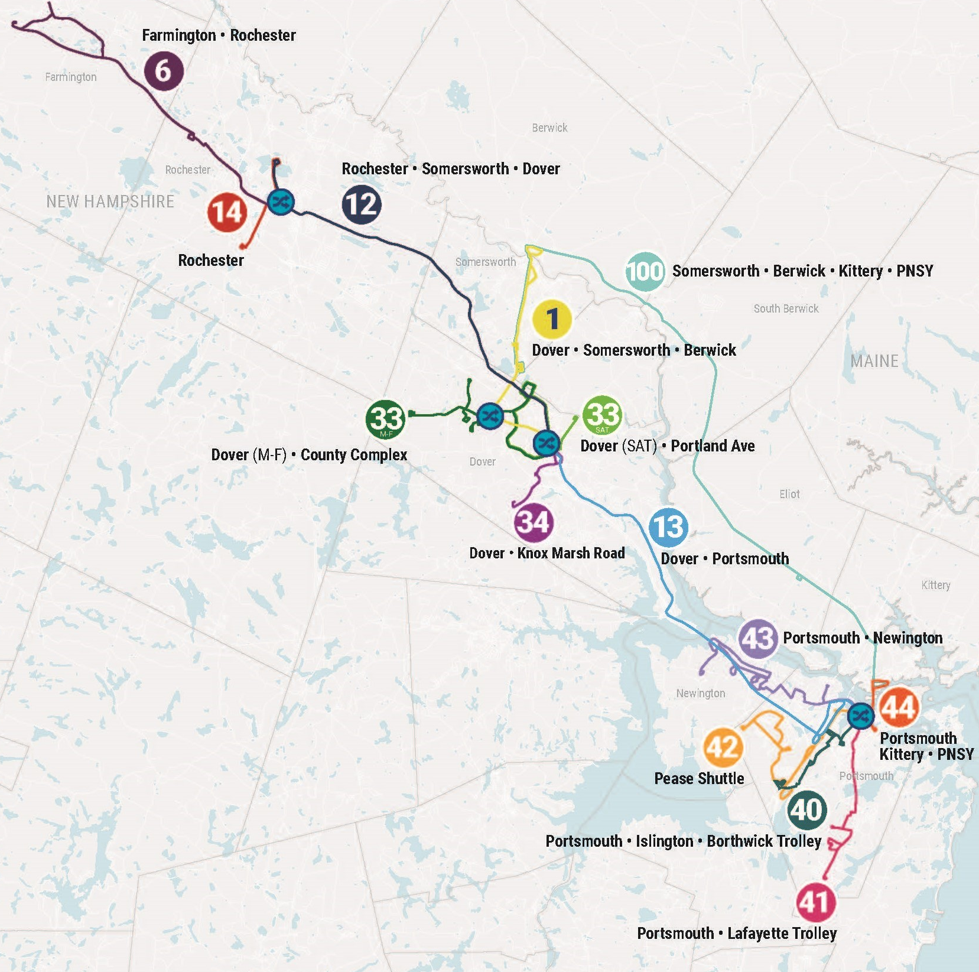
About COAST
501(c)3 Nonprofit
Serving 13 communities in New Hampshire and Maine with Fixed Route and Demand Response Programs.
43 years, 16 mil+ rides
Regional connector – serves Amtrak station & connects with Wildcat Transit

Slide 3

Connecting a Region, Driving the Economy
COAST is the common thread that runs through the region, connecting people to work, school, medical services, shopping, events, and recreation, and helps drive the region’s economy
$1
$31 million / year
  spent on COAST generates
  COAST’s estimated economic impact in the region (includes COAST’s direct, indirect, and induced effects on spending, as well as the economic impact of access provided by our services)
$4.08
  in local economic activity

Slide 4
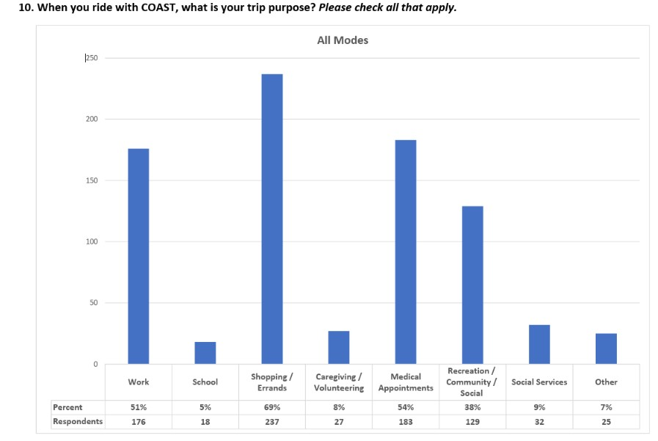
Knowing the Numbers
Top 3 Primary Trip Purposes:
Shopping
Medical
Work

Slide 5
Employer/
Business Partnership Opportunities at COAST

Slide 6
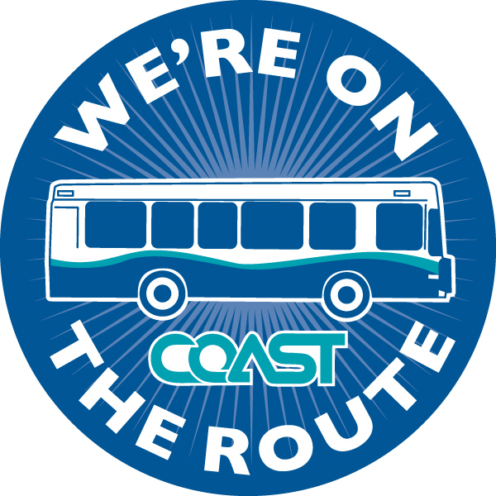
We’re On The Route!
Free Cross-Marketing Program
Showcases all the businesses you can get to on COAST’s system
Let’s patrons and employees know a business is accessible by bus

Slide 7
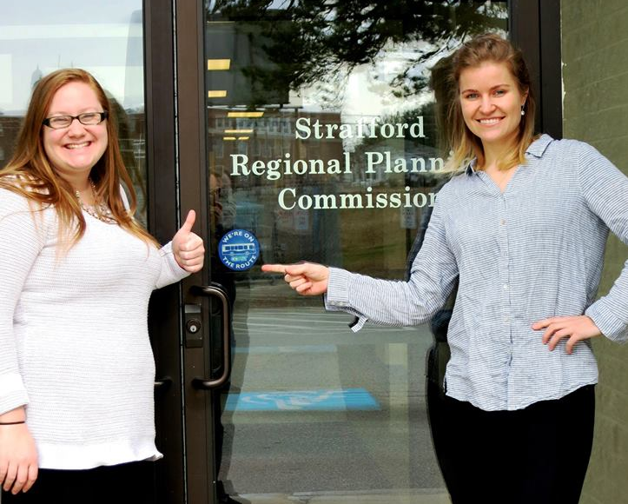
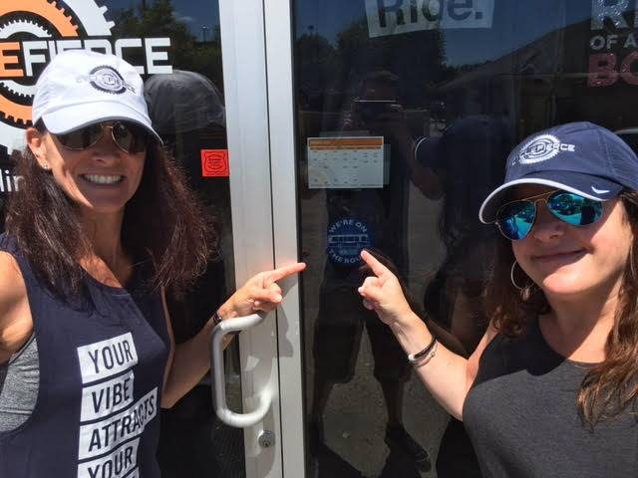
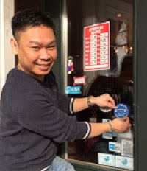
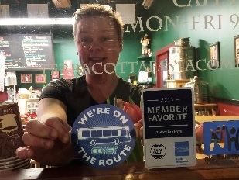
We’re On The Route!

Slide 8
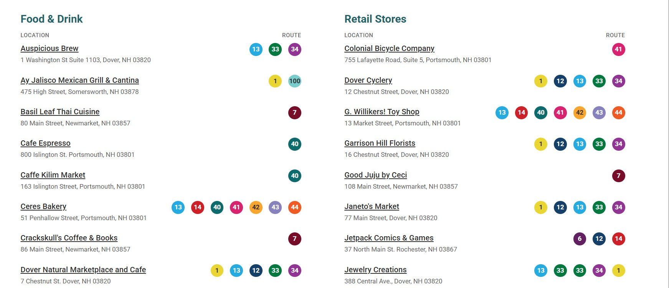
We’re On The Route!

Slide 9
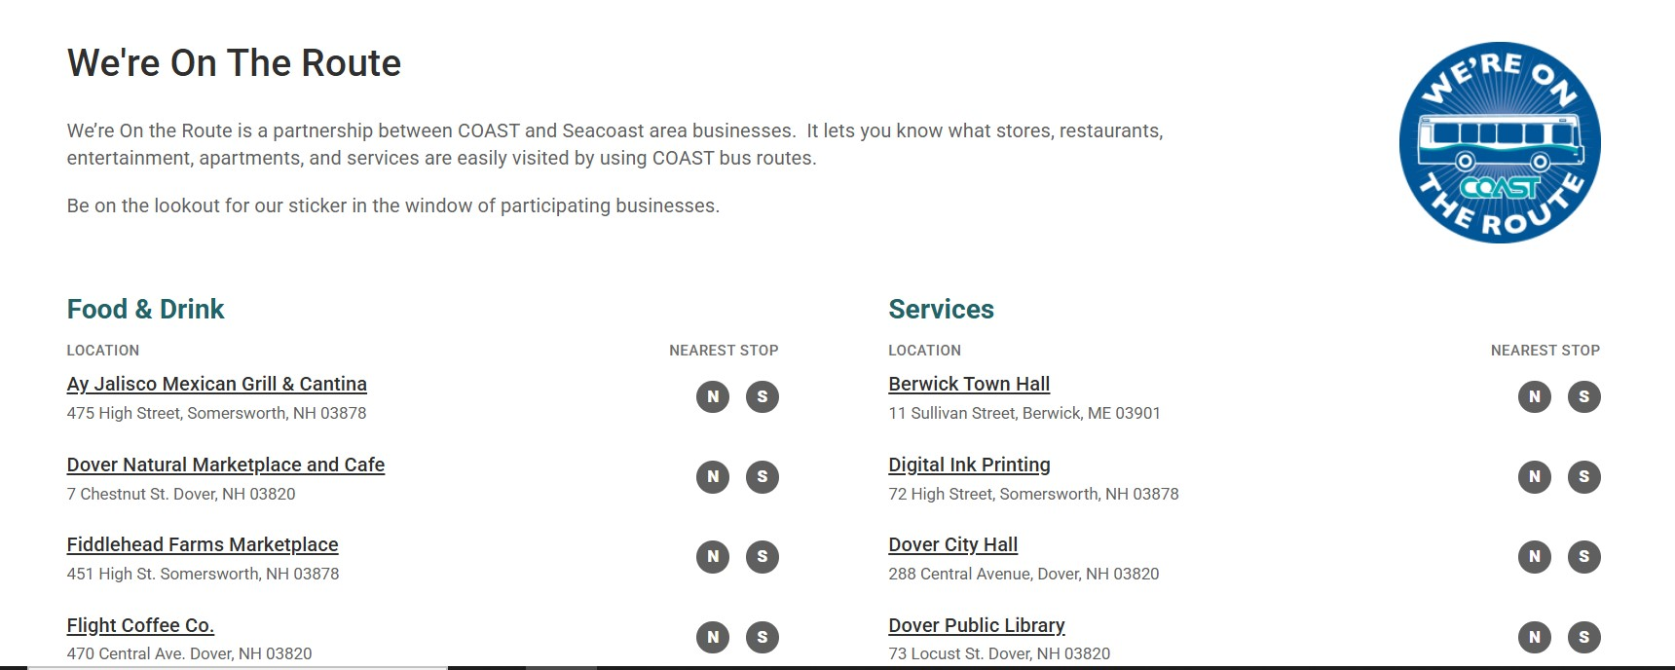
We’re On The Route!

Slide 10
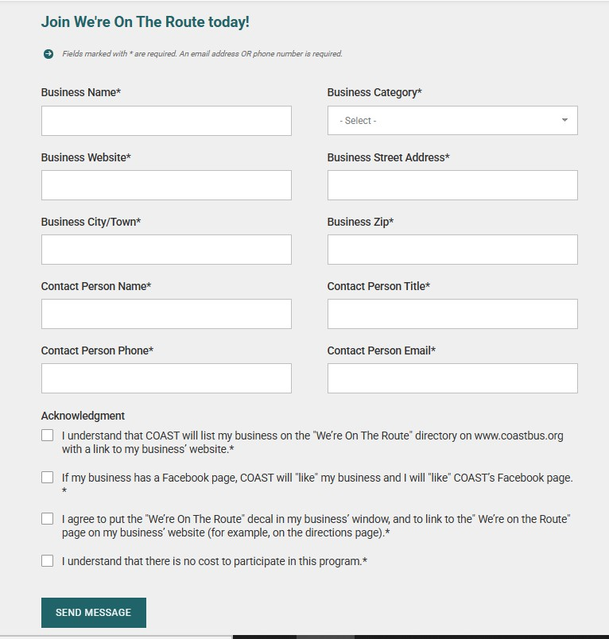
We’re On The Route!
What’s required of you:
Web set up & initial community outreach
Dedicated person to respond to incoming forms & update the website
Ongoing list maintenance (check every 3-6 months)
Branded window decals
Follow up with business after they’ve signed up (welcome cards with sticker)
Enjoy seeing your logo on all the downtown windows!

Slide 11
We’re On The Route!
Benefits:
Reminds the business community of transit’s role in the economy & establishes goodwill
Increases brand awareness (both parties)
Shows ridership clearly specific businesses they can get to on your system
Creates fun! Like a transit treasure hunt in every downtown

Slide 12
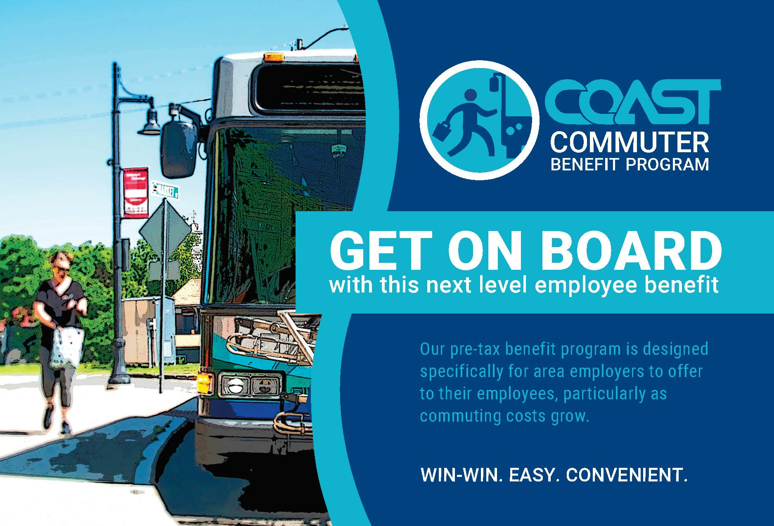
Commuter Benefit Program
The IRS allows commuters to pay for work-related transit with pre-tax dollars.
Businesses can partner with COAST to offer this benefit to employees, cutting down on payroll taxes, and offering employees a more affordable and green way to get to work.

Slide 13
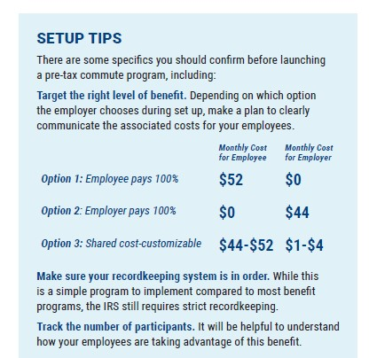
Commuter Pass Program
Designed to be flexible for employers
3 Options:
1) Employee pays 100% with pre-tax dollars. Employer sees federal payroll tax savings.
2) Employer pays 100% (COAST incentivizes this with a discount to the employer). Pass is offered to employee as a fully paid fringe benefit.
3) Shared cost (customizable). Employer chooses a contribution rate up to 7.5% ($4), which COAST will match up to $4. Total discount to employee is %15 ($8).

Slide 14
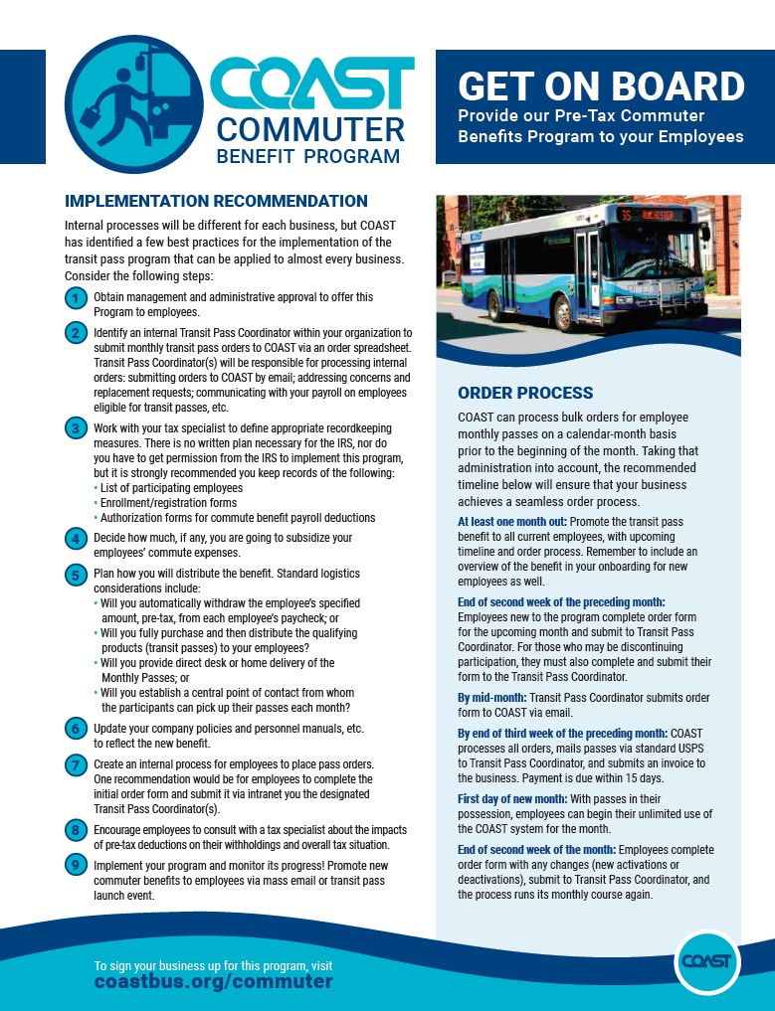
Can be a tough sell – requires employers to do some initial set up on their end.
Helps to have established positive relationships with the employers
Target employers who:
Have green initiatives in their missions
Are struggling with parking capacity
Have a workforce population that already uses transit or could greatly benefit from transit (one vehicle households, no vehicle, persistent vehicle issues)

Slide 15
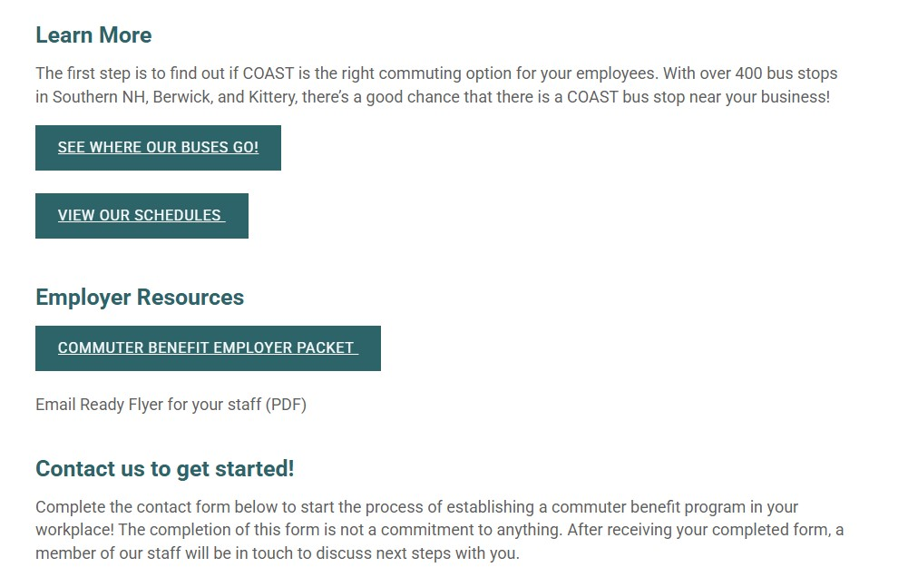
Commuter Pass Program
What’s required of you:
Create materials/packet to market the program to employers
Set up a page on your website with program information for employers
Set up system for tracking participating employers and discount levels
Training for your staff who sell tickets/passes
Initial meetings with the employer to set up processes that work for both parties
Ongoing check-ins with employer to see how things are going and if any tweaks/changes to the program are needed

Slide 16
Commuter Pass Program
What’s required of you:
Create materials/packet to market the program to employers
Set up a page on your website with program information for employers
Set up system for tracking participating employers and discount levels
Training for your staff who sell tickets/passes
Initial meetings with the employer to set up processes that work for both parties
Ongoing check-ins with employer to see how things are going and if any tweaks/changes to the program are needed

Slide 17
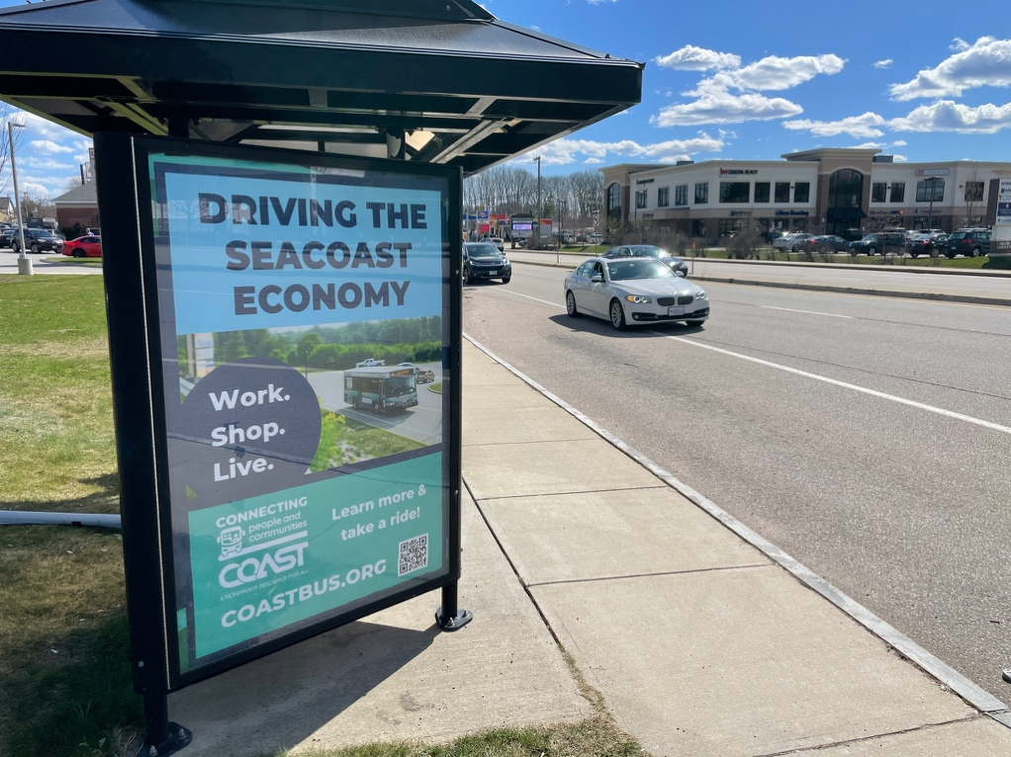
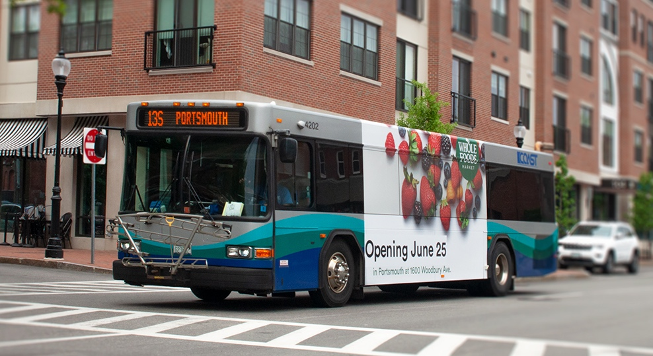
Advertise with COAST
Ready to take your marketing on the road? Advertise on COAST vehicles or in bus shelters.
14
  Buses
21
  Shelters

Slide 18
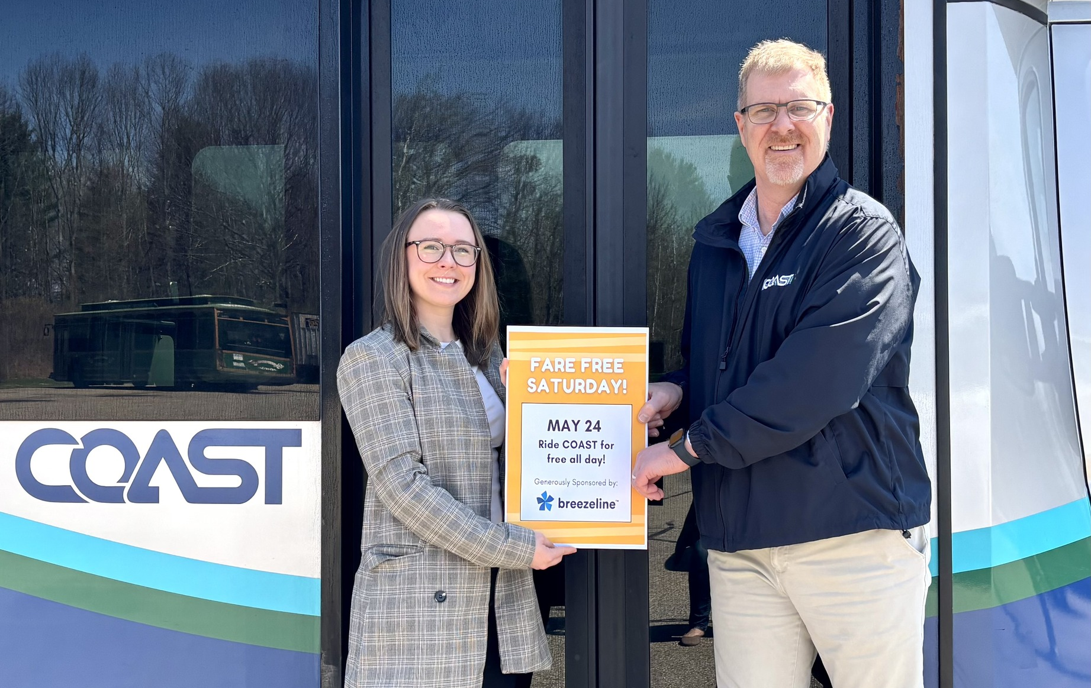
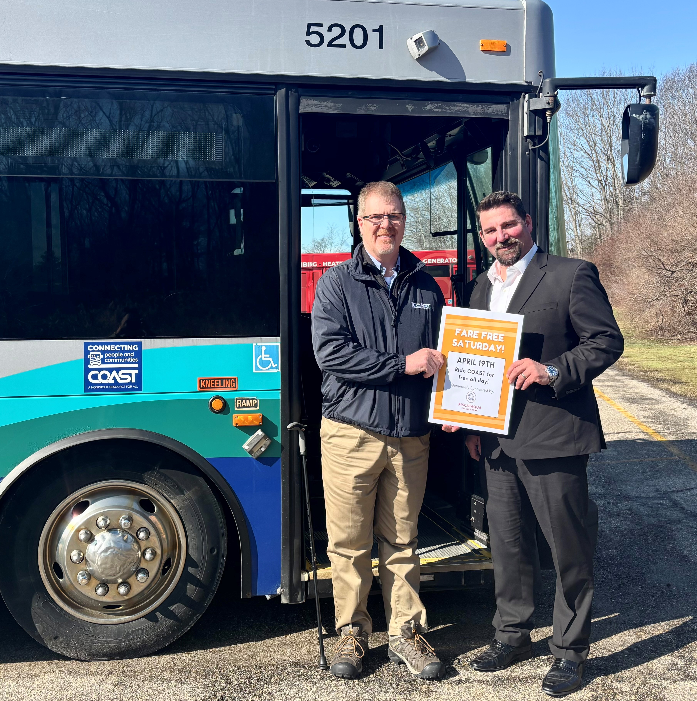
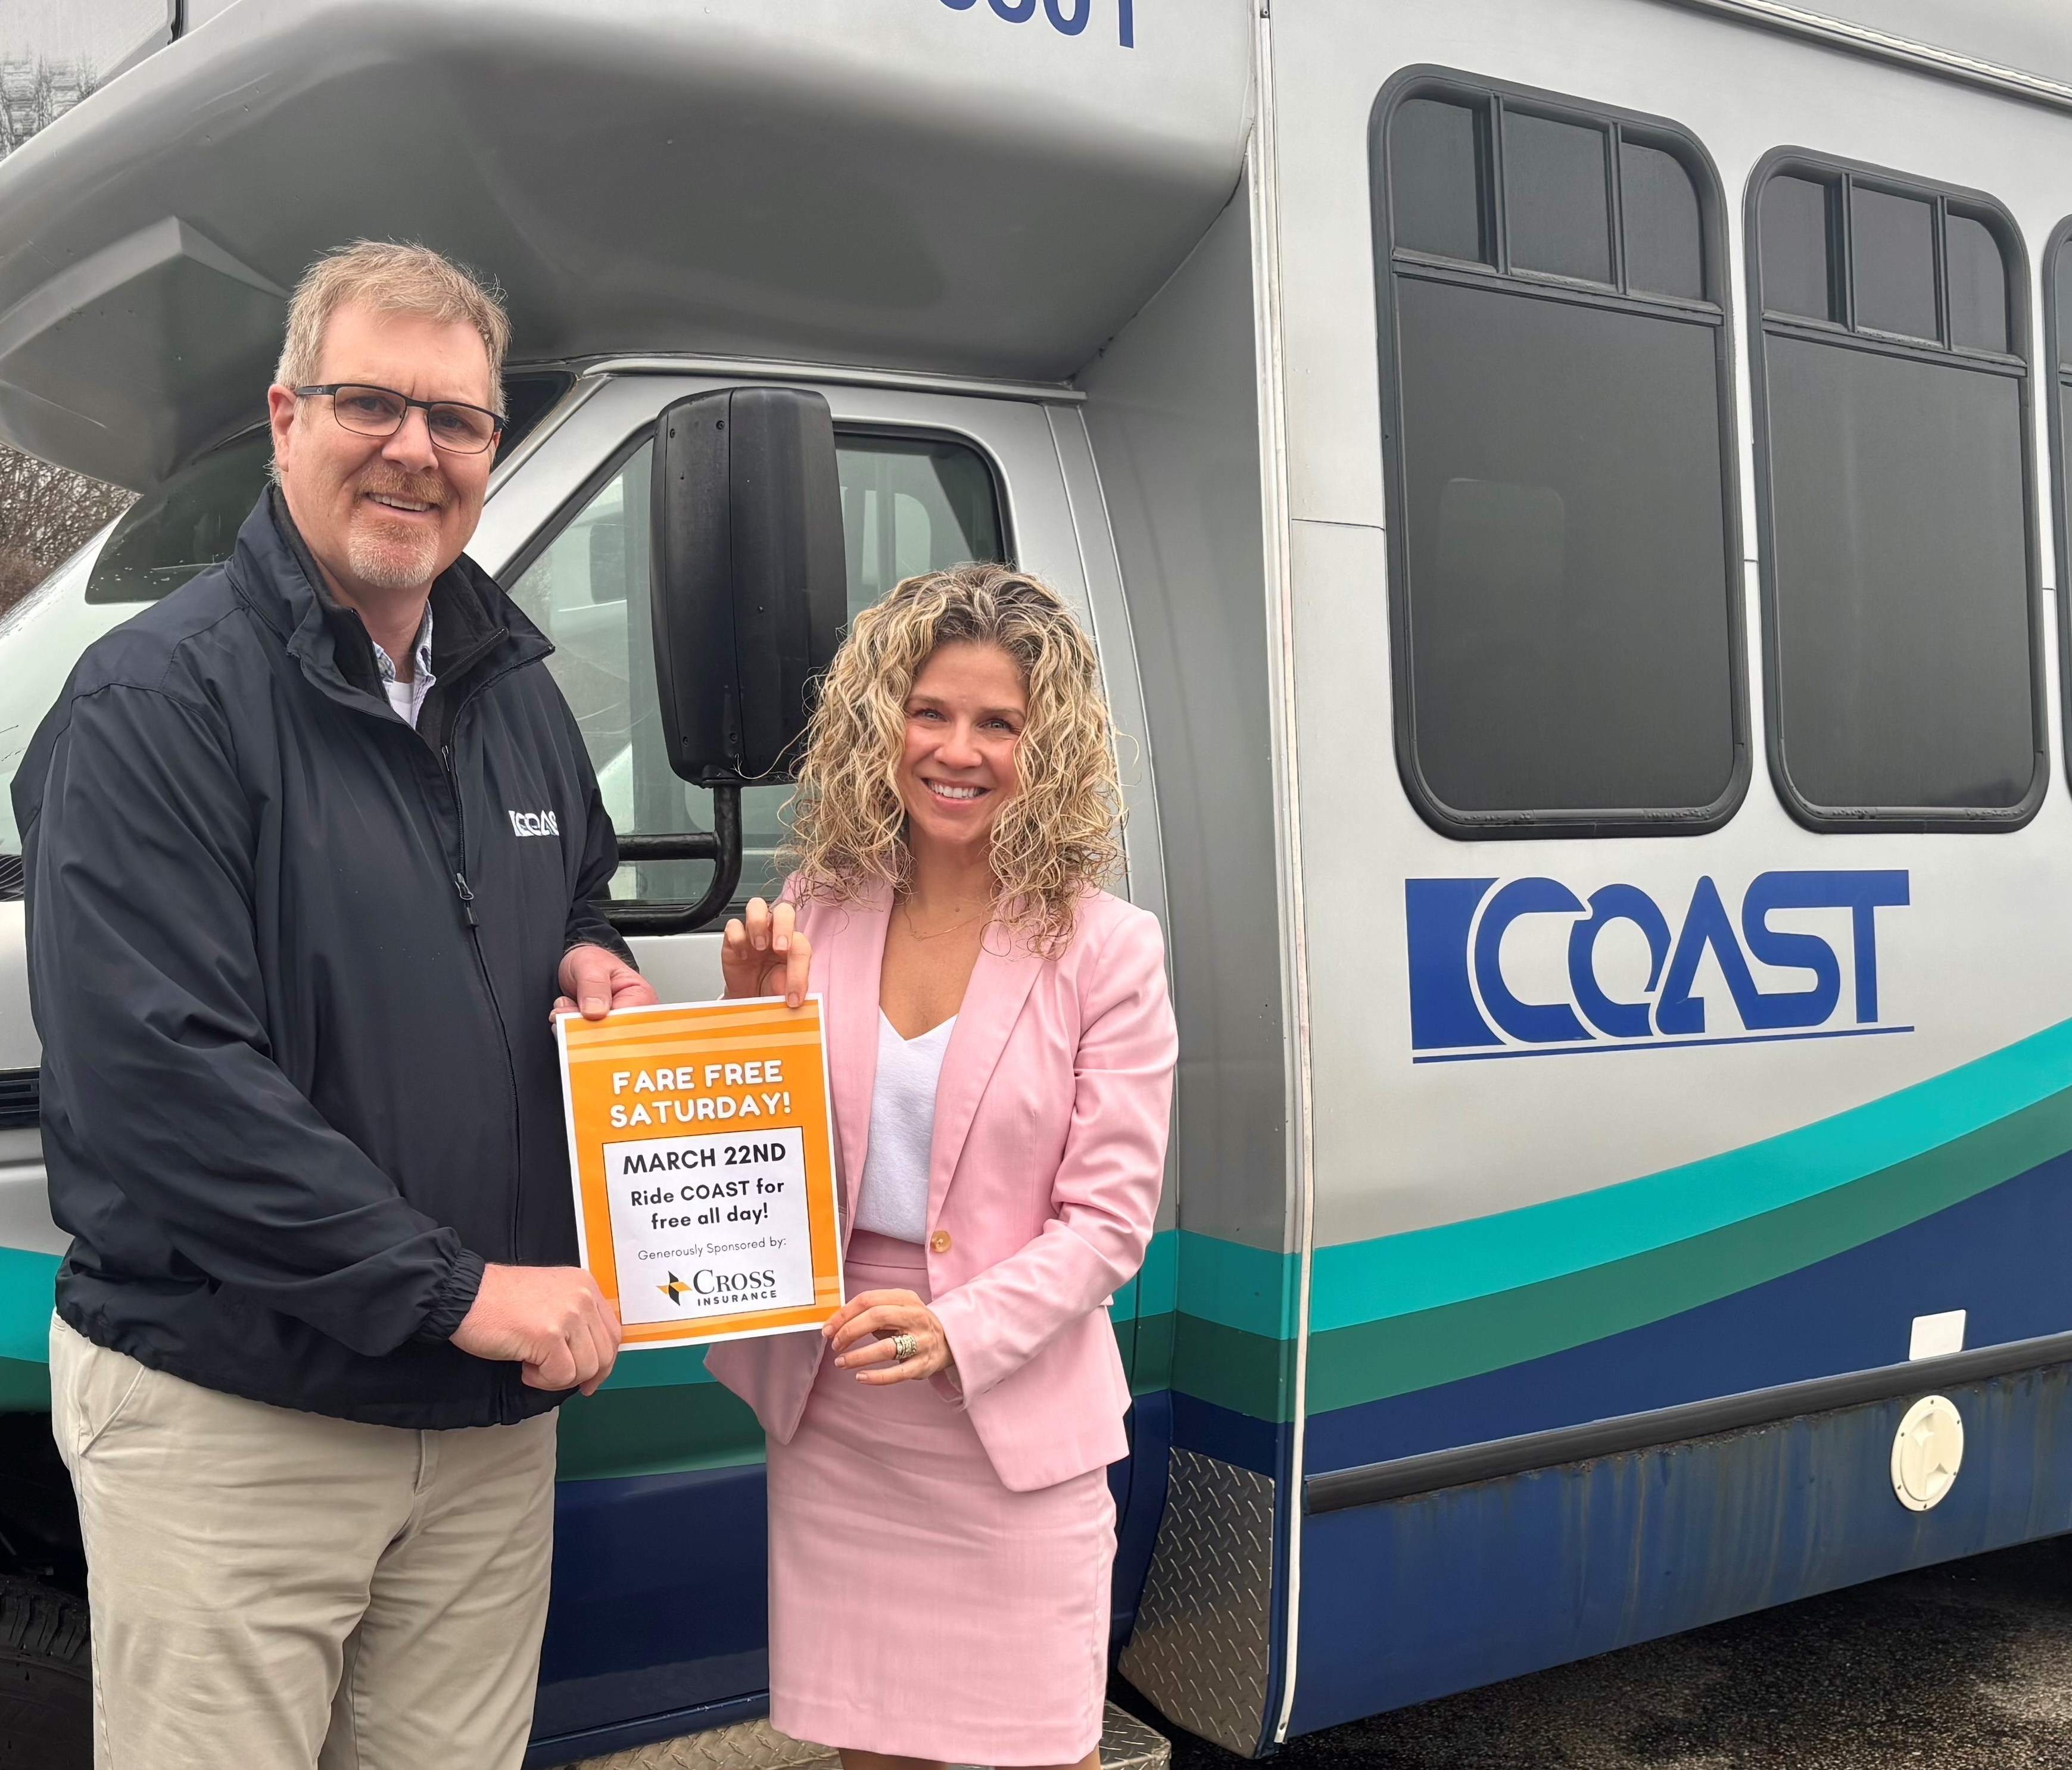
“Fare Free Saturday” Sponsorships
Local businesses can donate $2,500 to COAST to cover a day of fare revenue, allowing passengers to ride for free for the day.
Great PR exposure for the businesses
Builds relationships
Allows them to show their support for the local transit agency at fairly low cost
Passengers LOVE IT

Slide 19
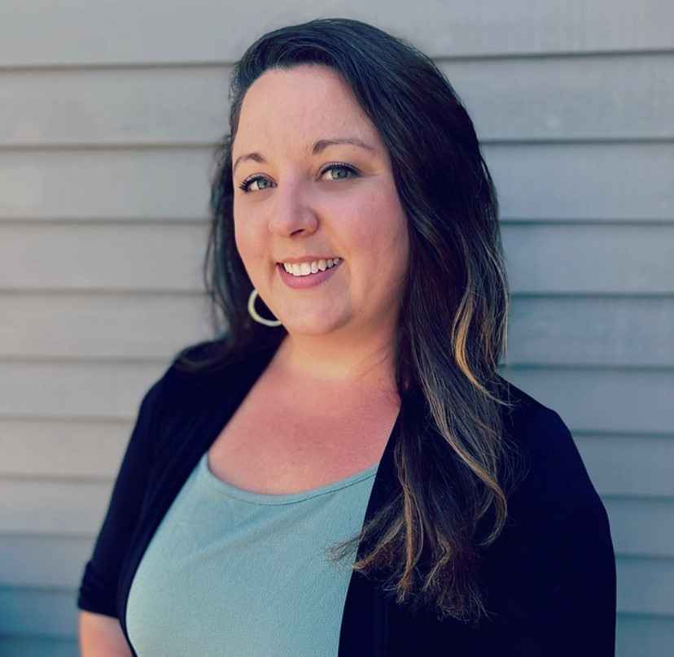

Thank you!
Vanessa Polychronis
Manager of HR & Community Engagement
vpolychronis@coastbus.org
603-516-0767
www.linkedin.com/in/vanessapolychronis
www.coastbus.org

