Slide 1

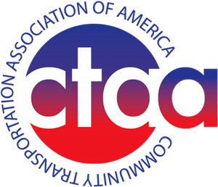
Community Transportation Association of America
What’s Happening in DC and What You Can Do
Tri-State Transit Conference
Sept. 4, 2025

Slide 2
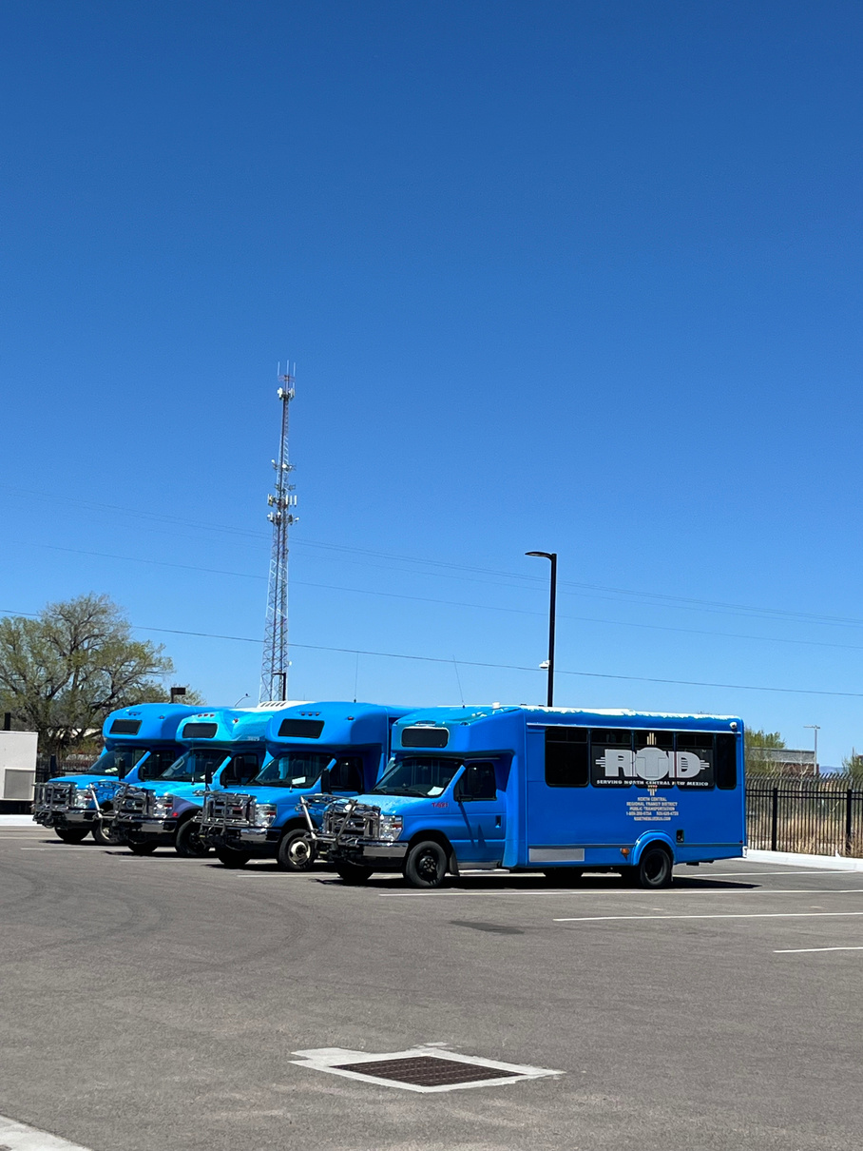
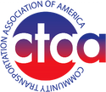
Fall 25 DC UPDATE
IIJA REAUTHORIZATION UNDERWAY
T&I Bill?, Senate Engaging, Administration proposal being developed
FTA REORGANIZATION
New leadership, significant staff reductions, capacity concerns, Bus NOFA decisions
FY26 APPROPRIATIONS
CR likely, Growth in Formula Programs

Slide 3

HTF Reality Check
IIJA Expires
Sept. 30, 2026
Key factor: When does the HTF run out of money?
Right in the middle of the mid-term elections
House T&I
Wants to finalize a bill in 2025. Hearings being held. Determined leadership.
IIJA REAUTHORIZATION UNDERWAY
Senate Banking
Progress underway in EPW, with Banking starting to engage.
Administration Proposal
The Administration’s proposal is being finalized.

Slide 4

Continued Federal Investment in Public Transit
A Consistent Federal Share for Operating Investment
Regulatory Reform for Smaller Transit Agencies
Increasing the Small Transit Intensive Cities Program (STIC)
Increase Formula Funds for Rural and Statewide Bus and Bus Facilities Investment
CTAA’s Reauthorization Priorities

Slide 5

CTAA’s Regulatory Reform Targets
Conflicting State and Federal Regulations
National Transit Database (NTD) Streamlining
Buy America Simplification
CDL “Under the Hood” Testing
NEPA and Property Acquisition
Risk-Based Oversight Programs
Used Bus Sales

Slide 6

FTA Changes
Staff Reductions
From 780 to 500, with a lot of familiar names leaving. Re-organization underway. Core capacity concerns.
Molinaro Takes the Helm
Former Congressman Marcus Molinaro (R-NY) was named FTA Administrator in August. Focus on outcomes, accessibility and innovation.

Slide 7
FY 2025
Finalized in March with slight increases to transit; follows IIJA
Appropriations &
Budget Reconciliation
President’s Budget
Lightly targets transportation programs; few details
FY 2026
Transit and the Big Beautiful Bill, potential appropriations
delays

Slide 8
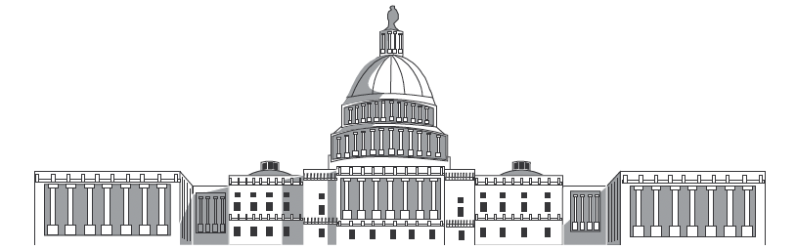
IIJA Reauthorization
Senate Banking Committee
Rural Transit Bill
House and Senate stand-alone bills with bi-partisan support increasing STIC set aside
CTAA’s Key Congressional Efforts

Slide 9


Key Transition Issues
Discretionary Grants & Rescissions
Formula vs. Competitive
What type of funding do you prefer?
Some discretionary grants are still
”under review”
The Fiscal Cliff
Impacts all transit systems, not just the largest UZAs
Master Agreements
Bus Capital
Sanctuary states and Executive Orders
Bus NOFA, new priorities, continued support, no-low survives

Slide 10

What Can You Do?
PROVIDE YOUR SERVICE
TELL YOUR STORY
STAY INFORMED
Focus on your value and outcomes
Keep up to date and engage.
Safely and efficiently

Slide 11
Provide Your Service
Know Your Customers and Community
Innovate and Adapt
Focus on Outcomes and Performance
Getting Back to Pre-COVID is NOT the Goal
Build Private Sector Partnerships

Slide 12
Telling Your Story
TARGET: LOCAL, STATE & FEDERAL ELECTEDS
Talk to everyone; tailor your message; build effective relationships; practice listening
THE VALUE OF NON-RIDERS
Support from the parts of the community that do not ride is essential to success
DATA-DRIVEN STORY TELLING
Know your numbers inside and out (ridership, safety, mapping, etc) and use them to paint a picture

Slide 13
Common Elements in Successful Transit Systems
Woven into community fabric
Leadership with a long(er) range vision
Managing bus and driver challenges
Changing, adapting, evolving, dynamic
Effective relationships with local leaders
Staff has technical capacity
Productive and engaged board

Slide 14

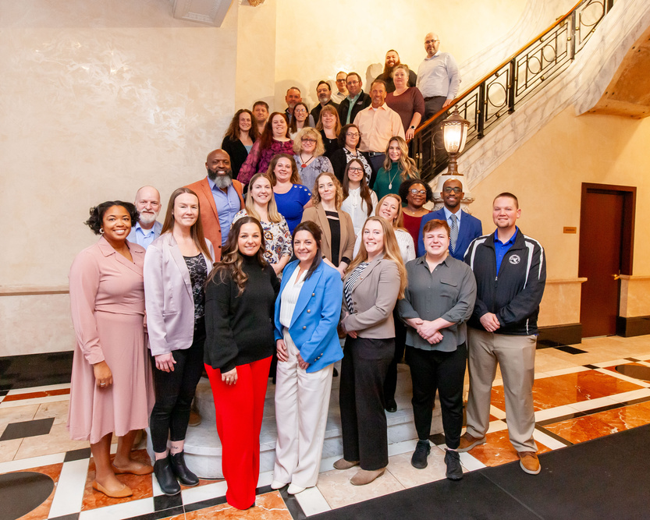
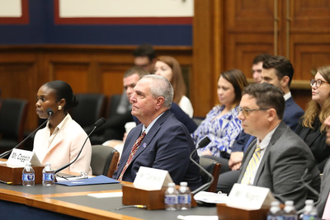
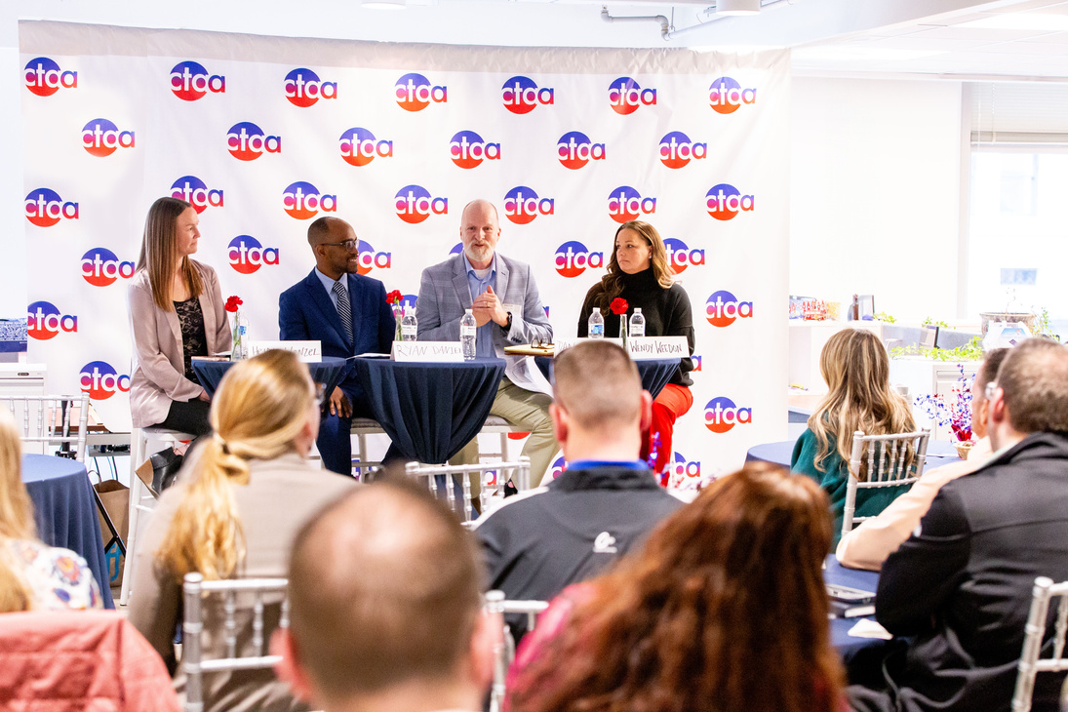
Upcoming CTAA Events
CTAA EXPO
CTAA Hill Day
CTAA Leadership
Academy
Omaha, NE
May 10-13, 2026
Washington, DC
March 4-6, 2026
Washington, DC
March 1-6, 2026

Slide 15
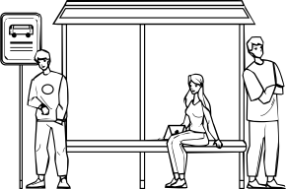
Contact us
Scott Bogren
bogren@ctaa.org
Website
www.CTAA.org
Phone
202.247.1921 (cell)

