Slide 1
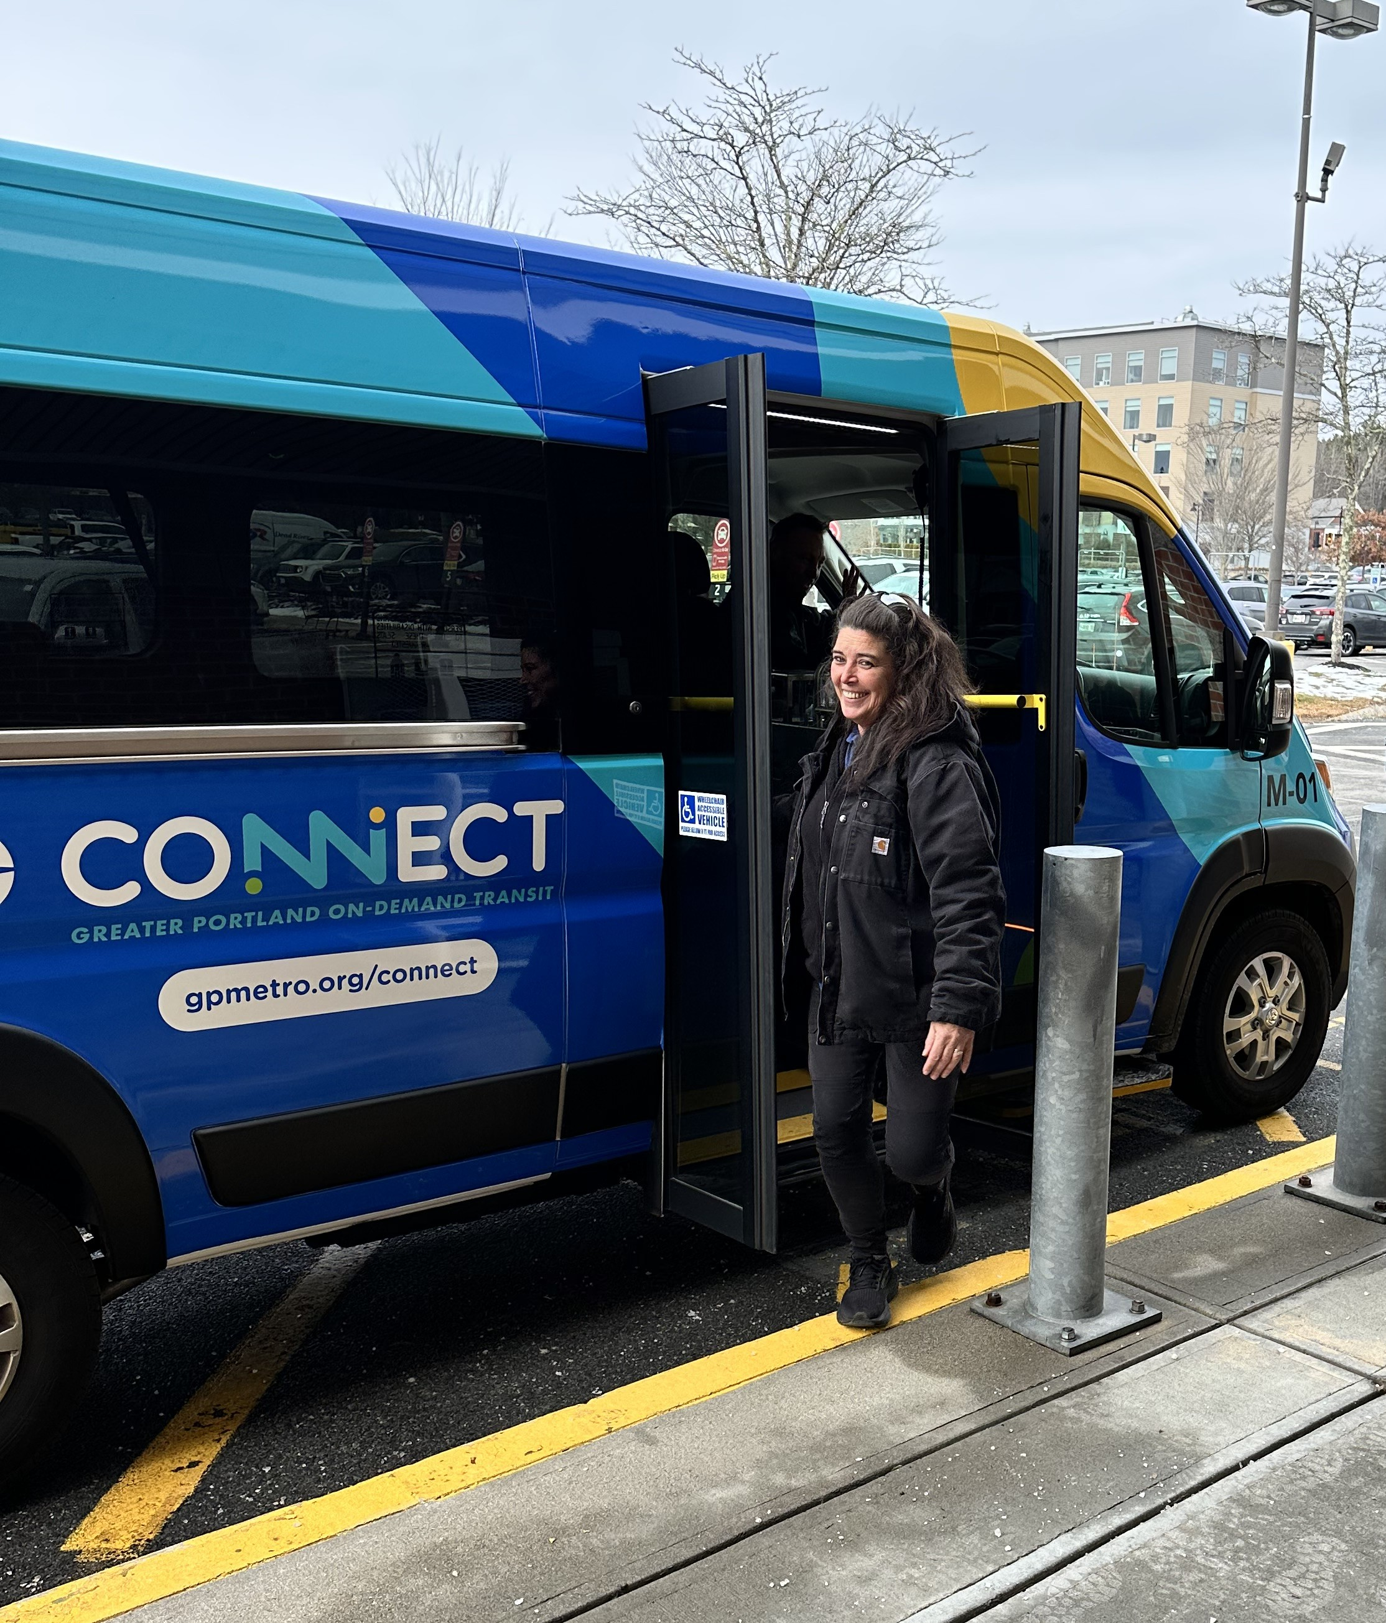

MICROTRANSIT IN
GREATER PORTLAND
Presented by:
Mike Tremblay
Director of Transit Development
Greater Portland Metro
September 4, 2025

Slide 2
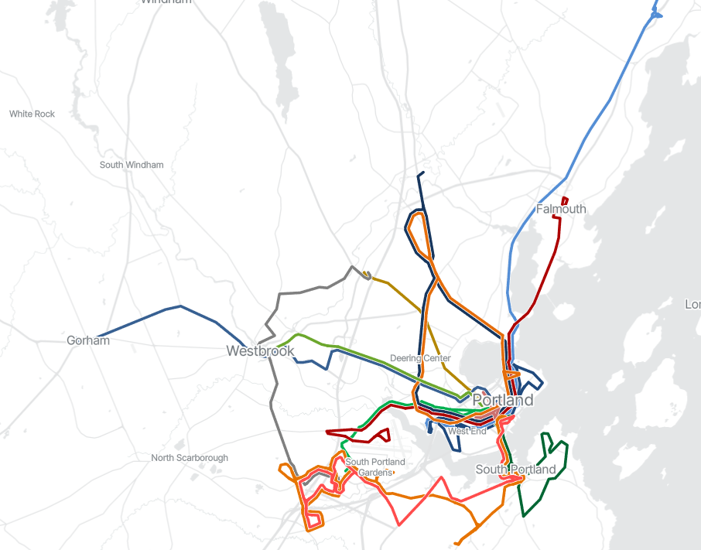
Greater Portland Metro
At A Glance
Greater Portland Metro in 2025
A snapshot
Ridership ~1.8 million
Approx. 110,000 annual revenue hours
49 fixed route vehicles
13 fixed route bus routes
1 on-demand microtransit service
Paratransit operated by 3rd party

Slide 3
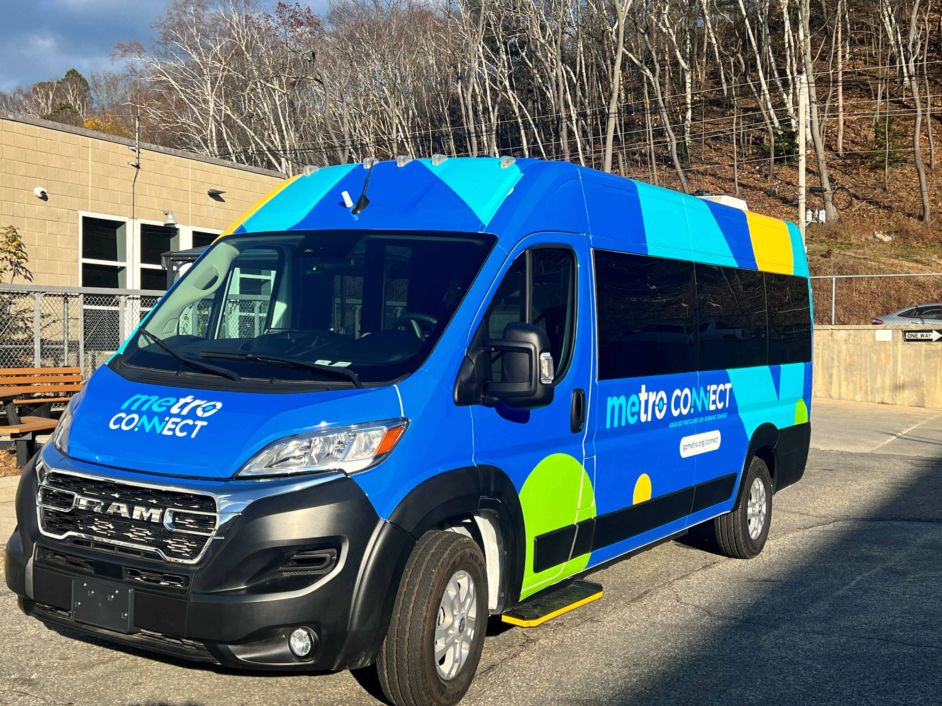
Part 1: What is microtransit?

Slide 4
What is microtransit?
A brief overview
What is microtransit?
Very similar to ADA paratransit, usually without door-to-door assistance
Can cover a large area without a meandering fixed route
Smaller vehicle can navigate local streets/driveways
Potential to suffer when demand is high
Demand-response transit
  Often app-based
Schedules and dispatches trips automatically based on customizable parameters
Pick-ups and drop-offs “curb to curb” at virtual pickup points
Smaller vehicle than fixed-route bus service

Slide 5
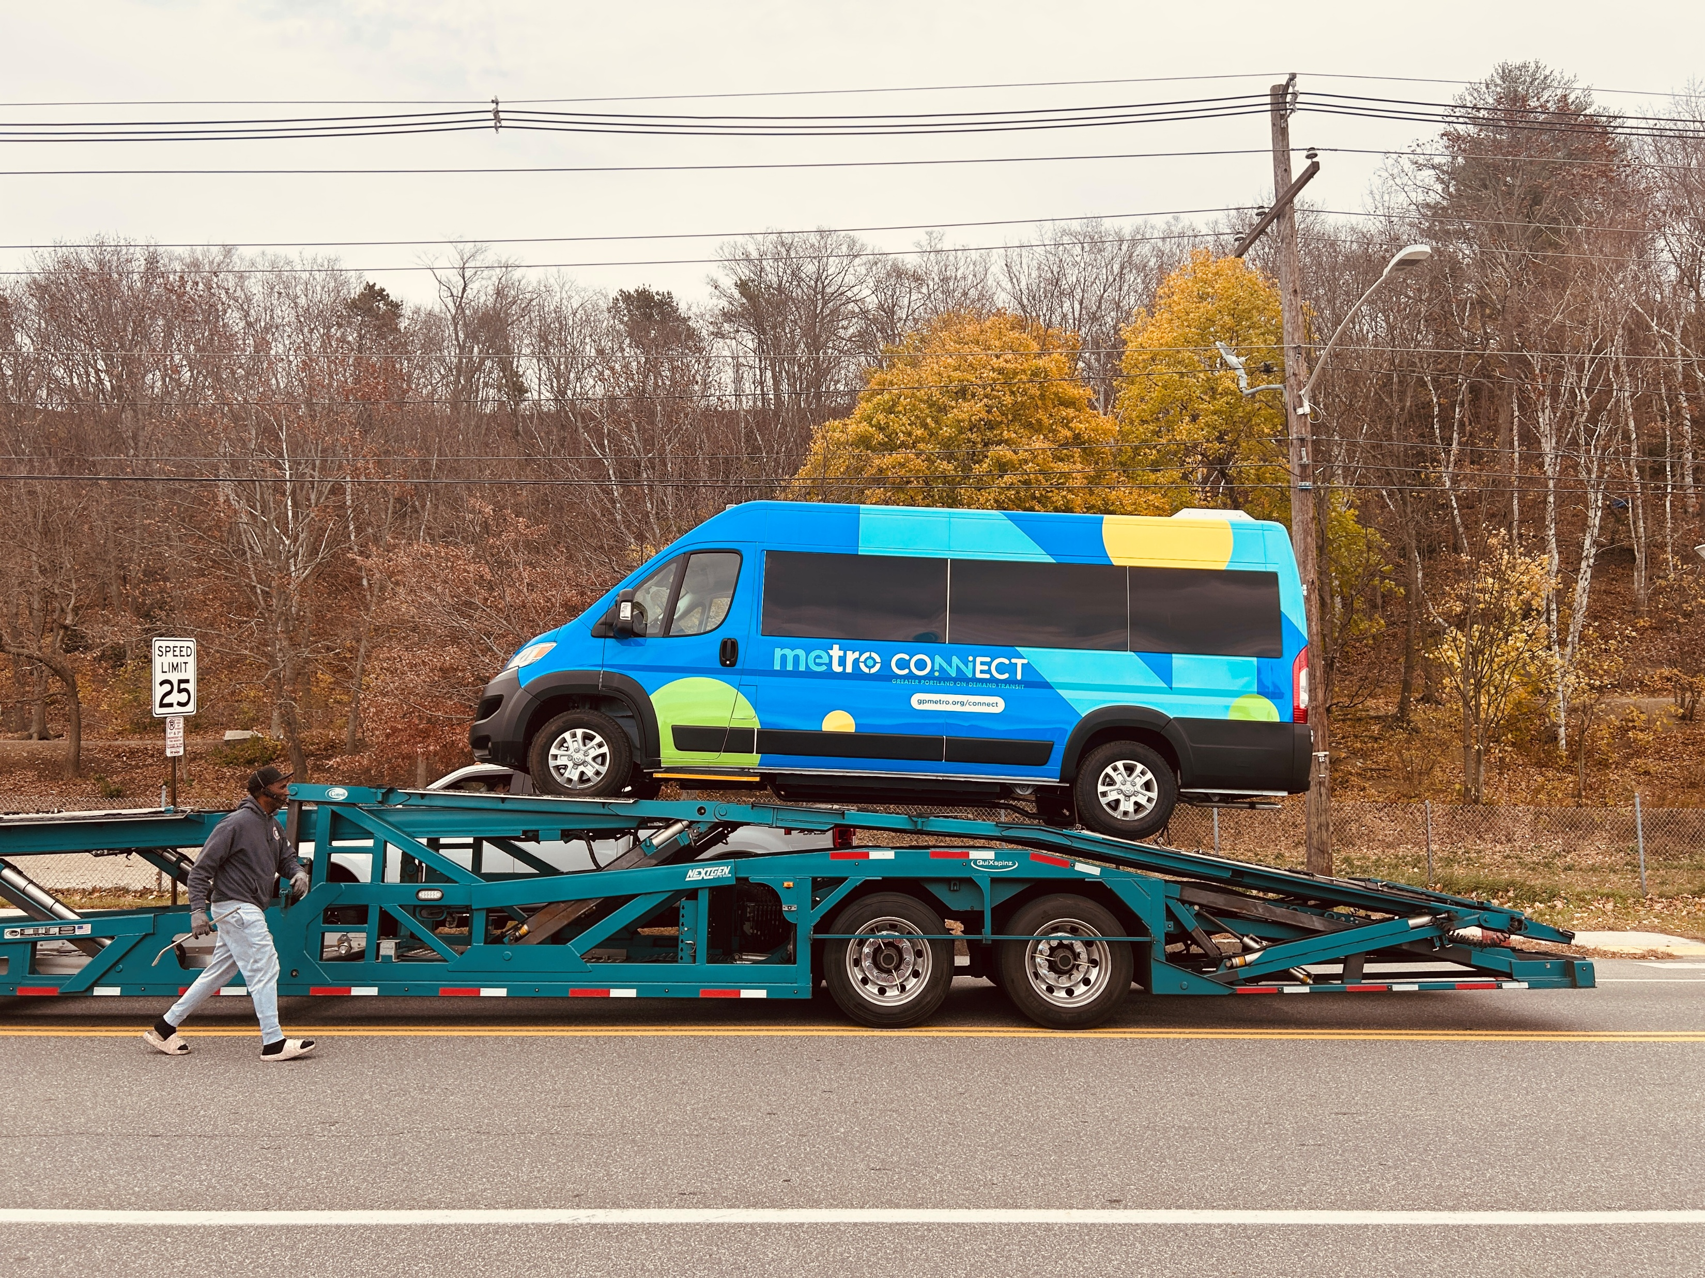
Part 2: Why microtransit?

Slide 6
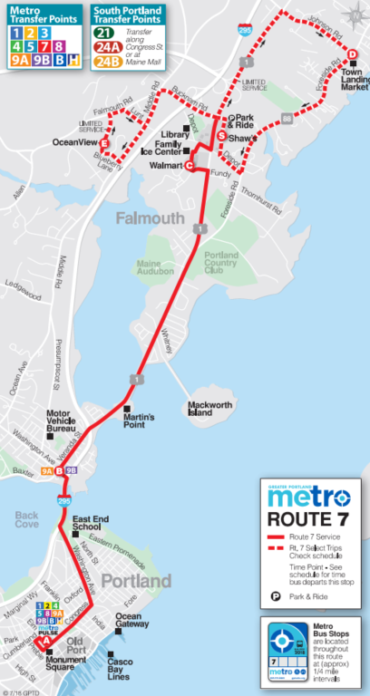
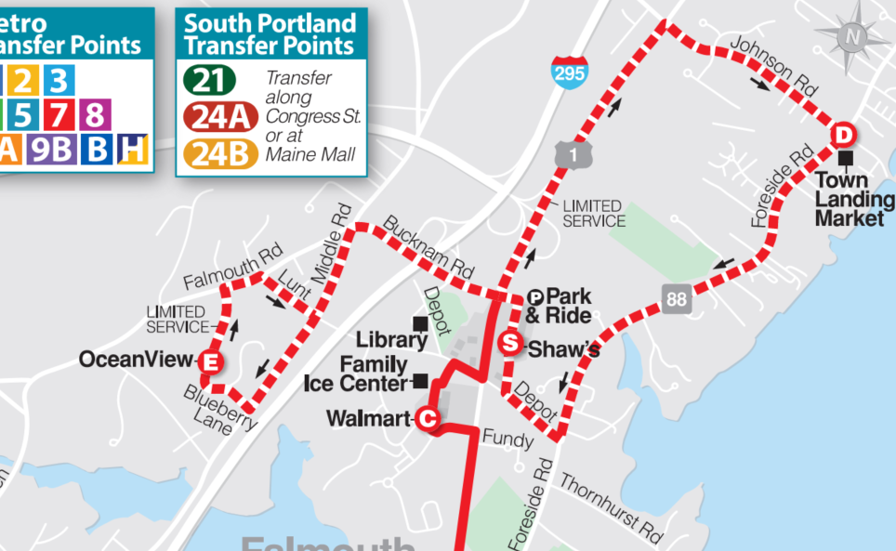
Why microtransit?
Route 7
Route 7
Service Profile
Lowest ridership of all Metro routes in 2022
  43,000 rides
Low level of service
  Hourly
  6:30am – 7:30pm Mon-Sat
  Less on Sunday
Service to downtown Portland
Approx 25% of service hours spent circulating “loops” in Falmouth neighborhoods – with little ridership to show for it

Slide 7
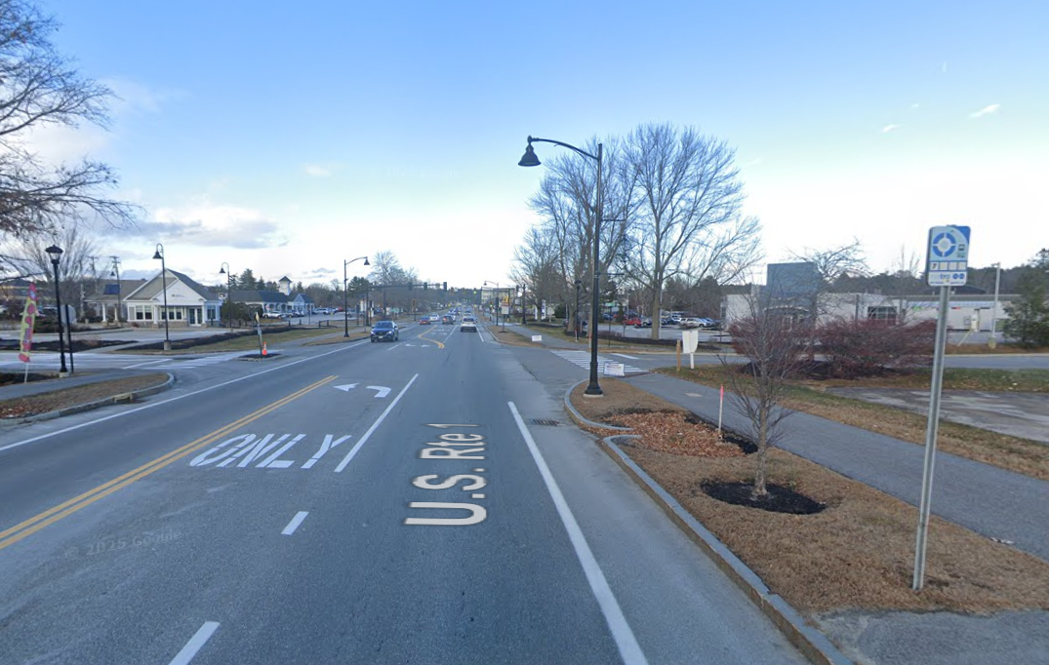
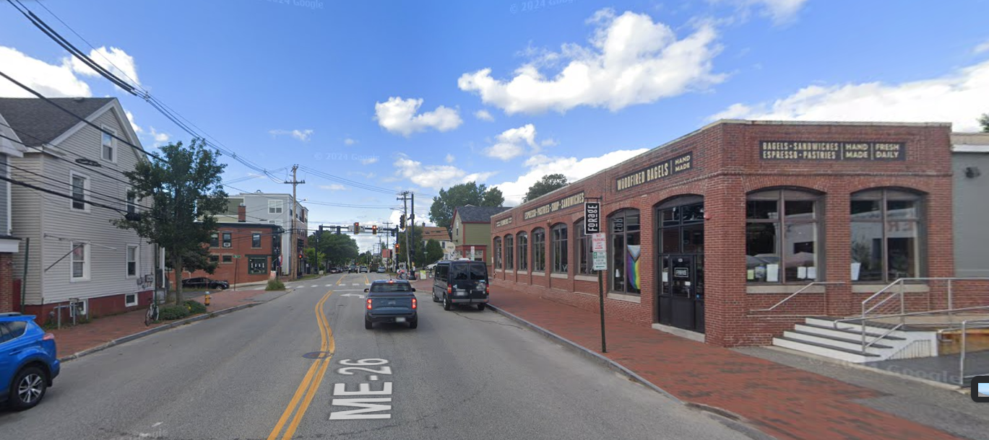
Why microtransit?
Route 7 Snapshots
U.S. Route 1
Falmouth
Route 7
“Mainline” service
Medium/high density
Mixed use/commercial uses
Sidewalks typ. on both sides
Speeds 25-35mph
Regular crosswalks
Washington Avenue
Portland

Slide 8
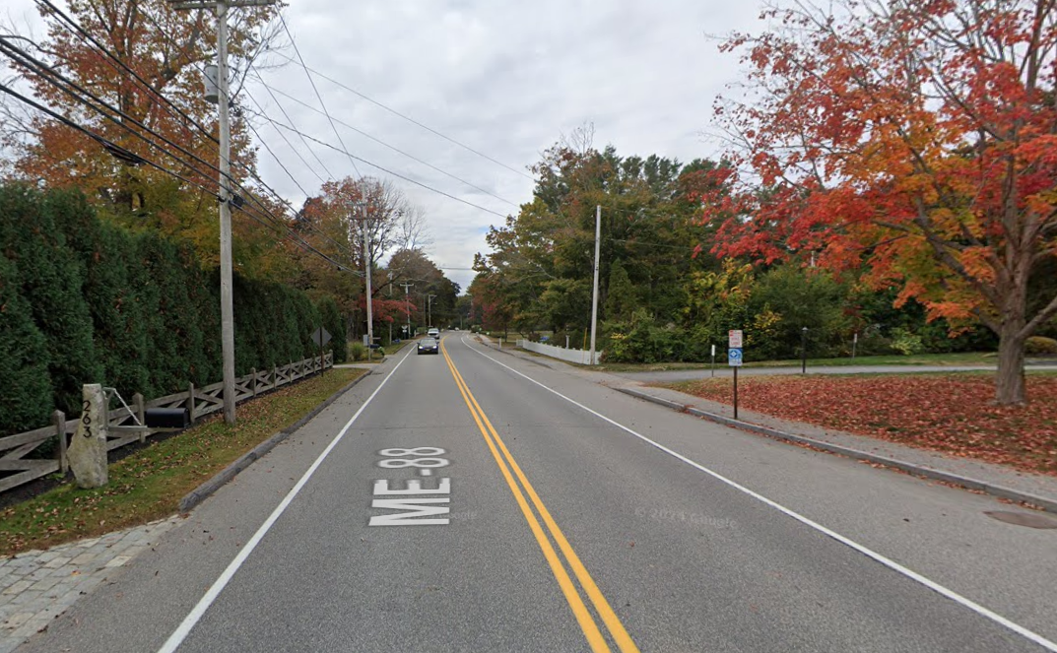
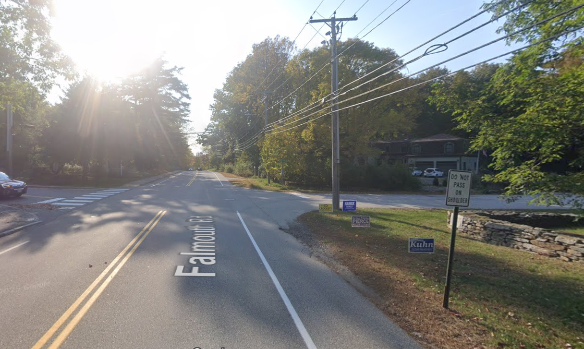
Why microtransit?
Route 7 Snapshots
Route 7
“Loop” service
Lower density development
Primarily residential
Sidewalks typ. on one side only
Faster speeds
Few crossing opportunities
Foreside Road
Falmouth
Falmouth Rd
Falmouth

Slide 9
Greater Portland Metro
At A Glance
Greater Portland Metro in 2022
A snapshot
Ridership ~1.26 million – 60% of 2019
Approx. 100,000 annual revenue hours
45 fixed route vehicles
10 fixed route bus routes
No on-demand services
Paratransit operated by 3rd party

Slide 10
Why microtransit?
Considerations
So, why microtransit?
Route 7 fixed route service had unproductive mileage
  Poor service levels
  Disadvantageous service profile
Municipal appetite to try something new rather than cut service
ARPA pilot funds available
Enabled improvements to fixed route service

Slide 11
Why microtransit?
Considerations
So, why microtransit?
American Rescue Plan Act
Capital and Pilot Projects
Seven-month regional reduced fare promo
Bus stop improvements
Transit signal priority
Pilot service improvements (15 months)
  Frequency enhancements on several routes
  Route extensions on two routes
  Microtransit pilot in Falmouth
Route 7 fixed route service had unproductive mileage
  Poor ridership
  Limited destinations
Municipal appetite to try something new rather than cut service
ARPA pilot funds available
Enabled improvements to fixed route service

Slide 12
Why microtransit?
Considerations
So, why microtransit?
American Rescue Plan Act
Capital and Pilot Projects
Seven-month regional reduced fare promo
Bus stop improvements
Transit signal priority
Pilot service improvements (15 months)
  Frequency enhancements on several routes
  Route extensions on two routes
  Microtransit pilot in Falmouth
Route 7 fixed route service had unproductive mileage
  Poor ridership
  Limited destinations
Municipal appetite to try something new rather than cut service
ARPA pilot funds available
Enabled improvements to fixed route service

Slide 13
Why microtransit?
Inefficient Fixed-Route Service

Slide 14
Why microtransit?
Inefficient Fixed Route Service

Slide 15
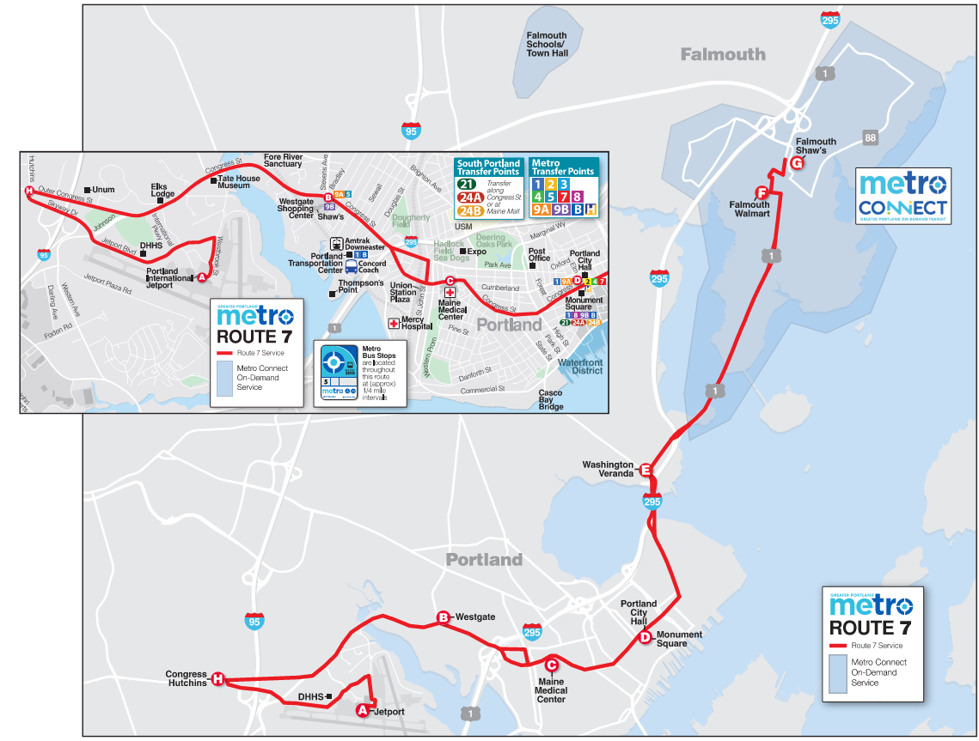
Why microtransit?
Improvements to fixed-route service

Slide 16
Why microtransit?
Improvements to fixed-route service
Service Enhancement Package
Expansion of Route 7 to Jetport
Removal of fixed route service outside US Route 1 in Falmouth
Microtransit in Falmouth
Service frequency improvements on Route 7
Span improvements on Route 7
Span/frequency improvements on other routes
Removal of Route 5 service deviations
    Operations

Slide 17
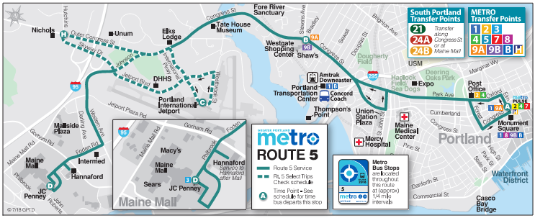
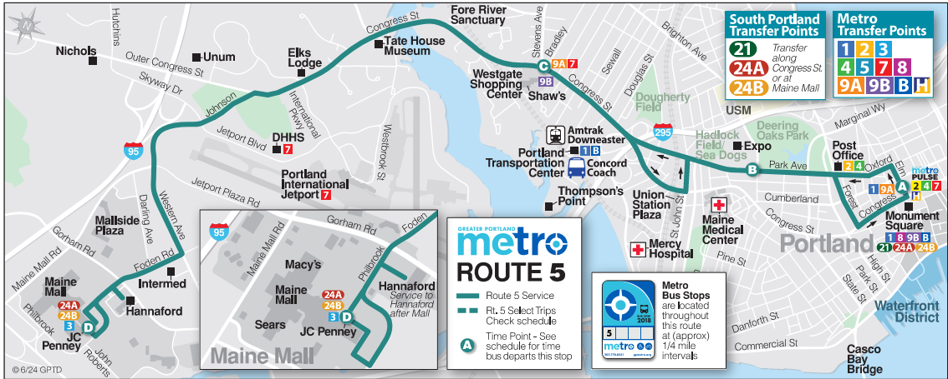
Why microtransit?
Improvements to fixed-route service

Slide 18
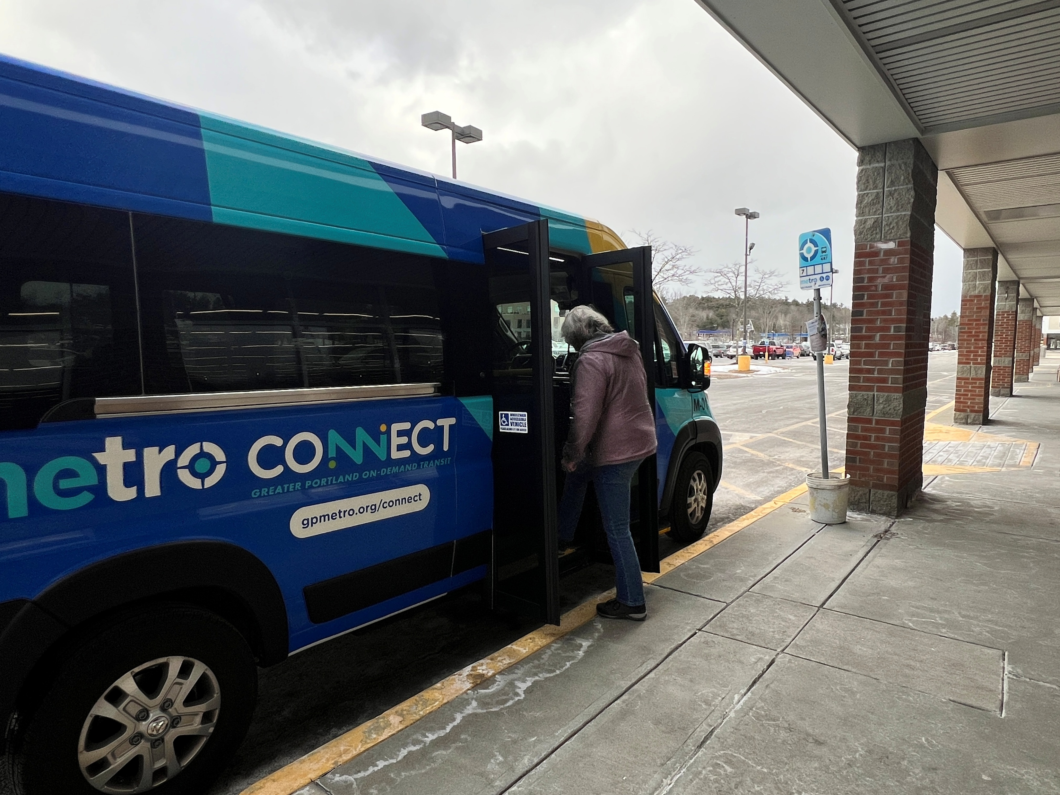
Part 3: Implementation

Slide 19
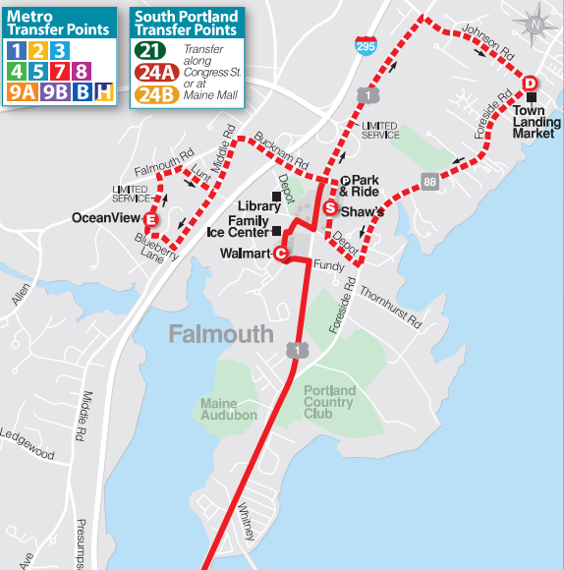
Microtransit Implementation
The Initial Zone
Route 7 “Loop” service
Snapshot
2,200 population within ¼ mile of stops
1,400 jobs within ¼ mile of stops
Service hourly, 13 times per day total
  Oceanview loop 3x per day
  Town Landing loop 10x per day
Service in clockwise direction only
  Little utility for trips in opposite direction
No useful service between loops

Slide 20
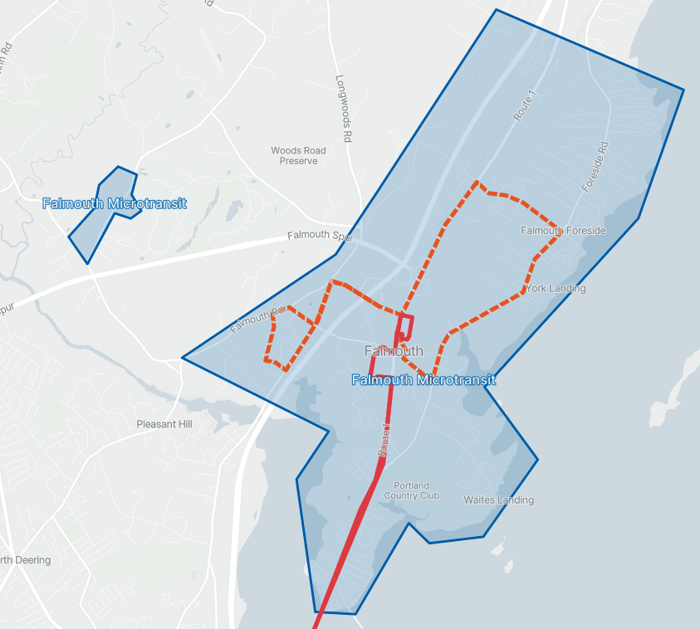
Microtransit Implementation
The Initial Zone
Prior Service
Initial microtransit zone
Route 7 mainline service
Route 7 “loop” service
Route 7 service remaining
Route 7 service removed

Slide 21
Microtransit Implementation
The Initial Zone
Initial microtransit zone
Microtransit Service Profile
Snapshot
5,400 population within zone
3,500 jobs within zone
Median wait times of less than 5 minutes
Free transfers to Route 7
Served by 1 vehicle
  16 hours Monday-Saturday
  8 hours Sunday
Route 7 service remaining
Route 7 service removed

Slide 22
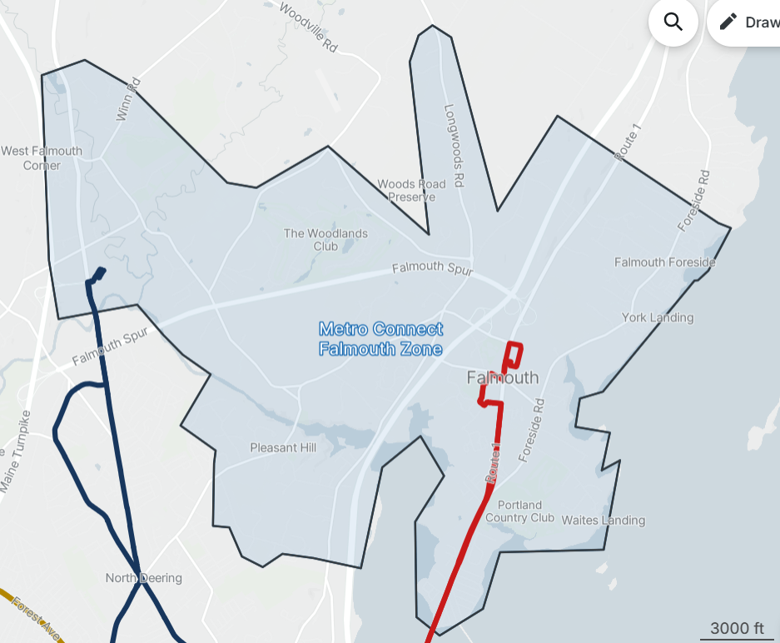
Microtransit Implementation
Expanded zone
Expanded microtransit zone
Microtransit Service Profile
Expanded Zone
7,800 population within zone
5,000 jobs within zone
Median wait times of just over 5 minutes
Connections to Route 7 and Route 9B
Served by 1 vehicle
  16 hours Monday-Saturday
  8 hours Sunday
Route 7 service remaining
Route 7 service removed

Slide 23

Microtransit Implementation
Software Vendor
Microtransit Client
Spare Labs
Selected after competitive procurement
User friendly apps for drivers, passengers, and service planning/scheduling
Brand-specific white-label app for passengers, with web client
Helped with initial product launch marketing materials
Vehicle itinerary generated and adjusted automatically as requests come in
Ability to co-mingle public transit with paratransit trips
Ability to plan trips over multiple transit modes
Spare is here – find Bronson to find out more

Slide 24
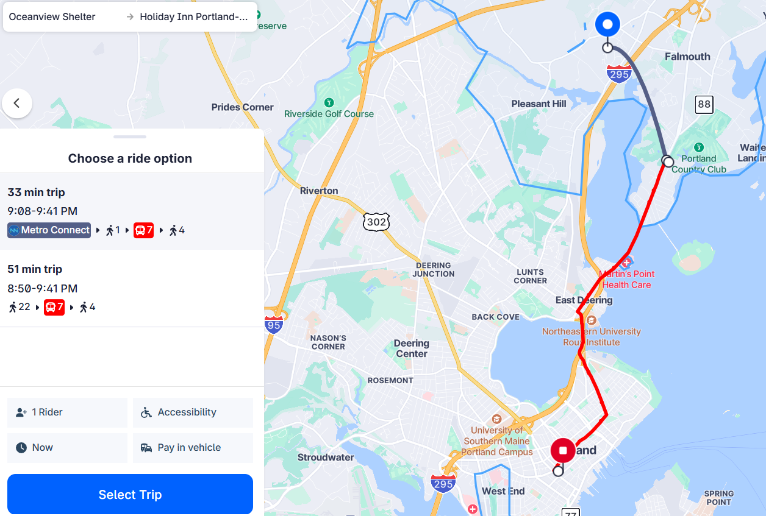
Microtransit Implementation
Trip Planning

Slide 25
Microtransit Implementation
Conclusions and Next Steps
Conclusions (so far)
Ridership averaging ~ 356 rides per month since March
  Cost per trip still much higher than fixed route service
  Able to serve target areas much better than fixed-route service could
  Additional expansion of zone possible

Slide 26
Microtransit Implementation
Conclusions and Next Steps
Conclusions (so far)
Ridership averaging ~ 356 rides per month since March
  Cost per trip still much higher than fixed route service
  Able to serve target areas much better than fixed-route service could
  Additional expansion of zone possible
Next Steps
Evaluation of Falmouth service
Falmouth service likely to be retained beyond ARPA-funded pilot period
Service may be modified to reflect ridership trends

Slide 27
Microtransit Implementation
Conclusions and Next Steps
Conclusions (so far)
Ridership averaging ~ 356 rides per month since March
  Cost per trip still much higher than fixed route service
  Able to serve target areas much better than fixed-route service could
  Additional expansion of zone possible
Next Steps
Evaluation of Falmouth service
Falmouth service likely to be retained beyond ARPA-funded pilot period
Service may be modified to reflect ridership trends
Next Steps
Expansion to New Areas
Microtransit expansion to South Portland and Scarborough likely in 2026
May play a role to serve lower-density pockets of our service area in the future

Slide 28
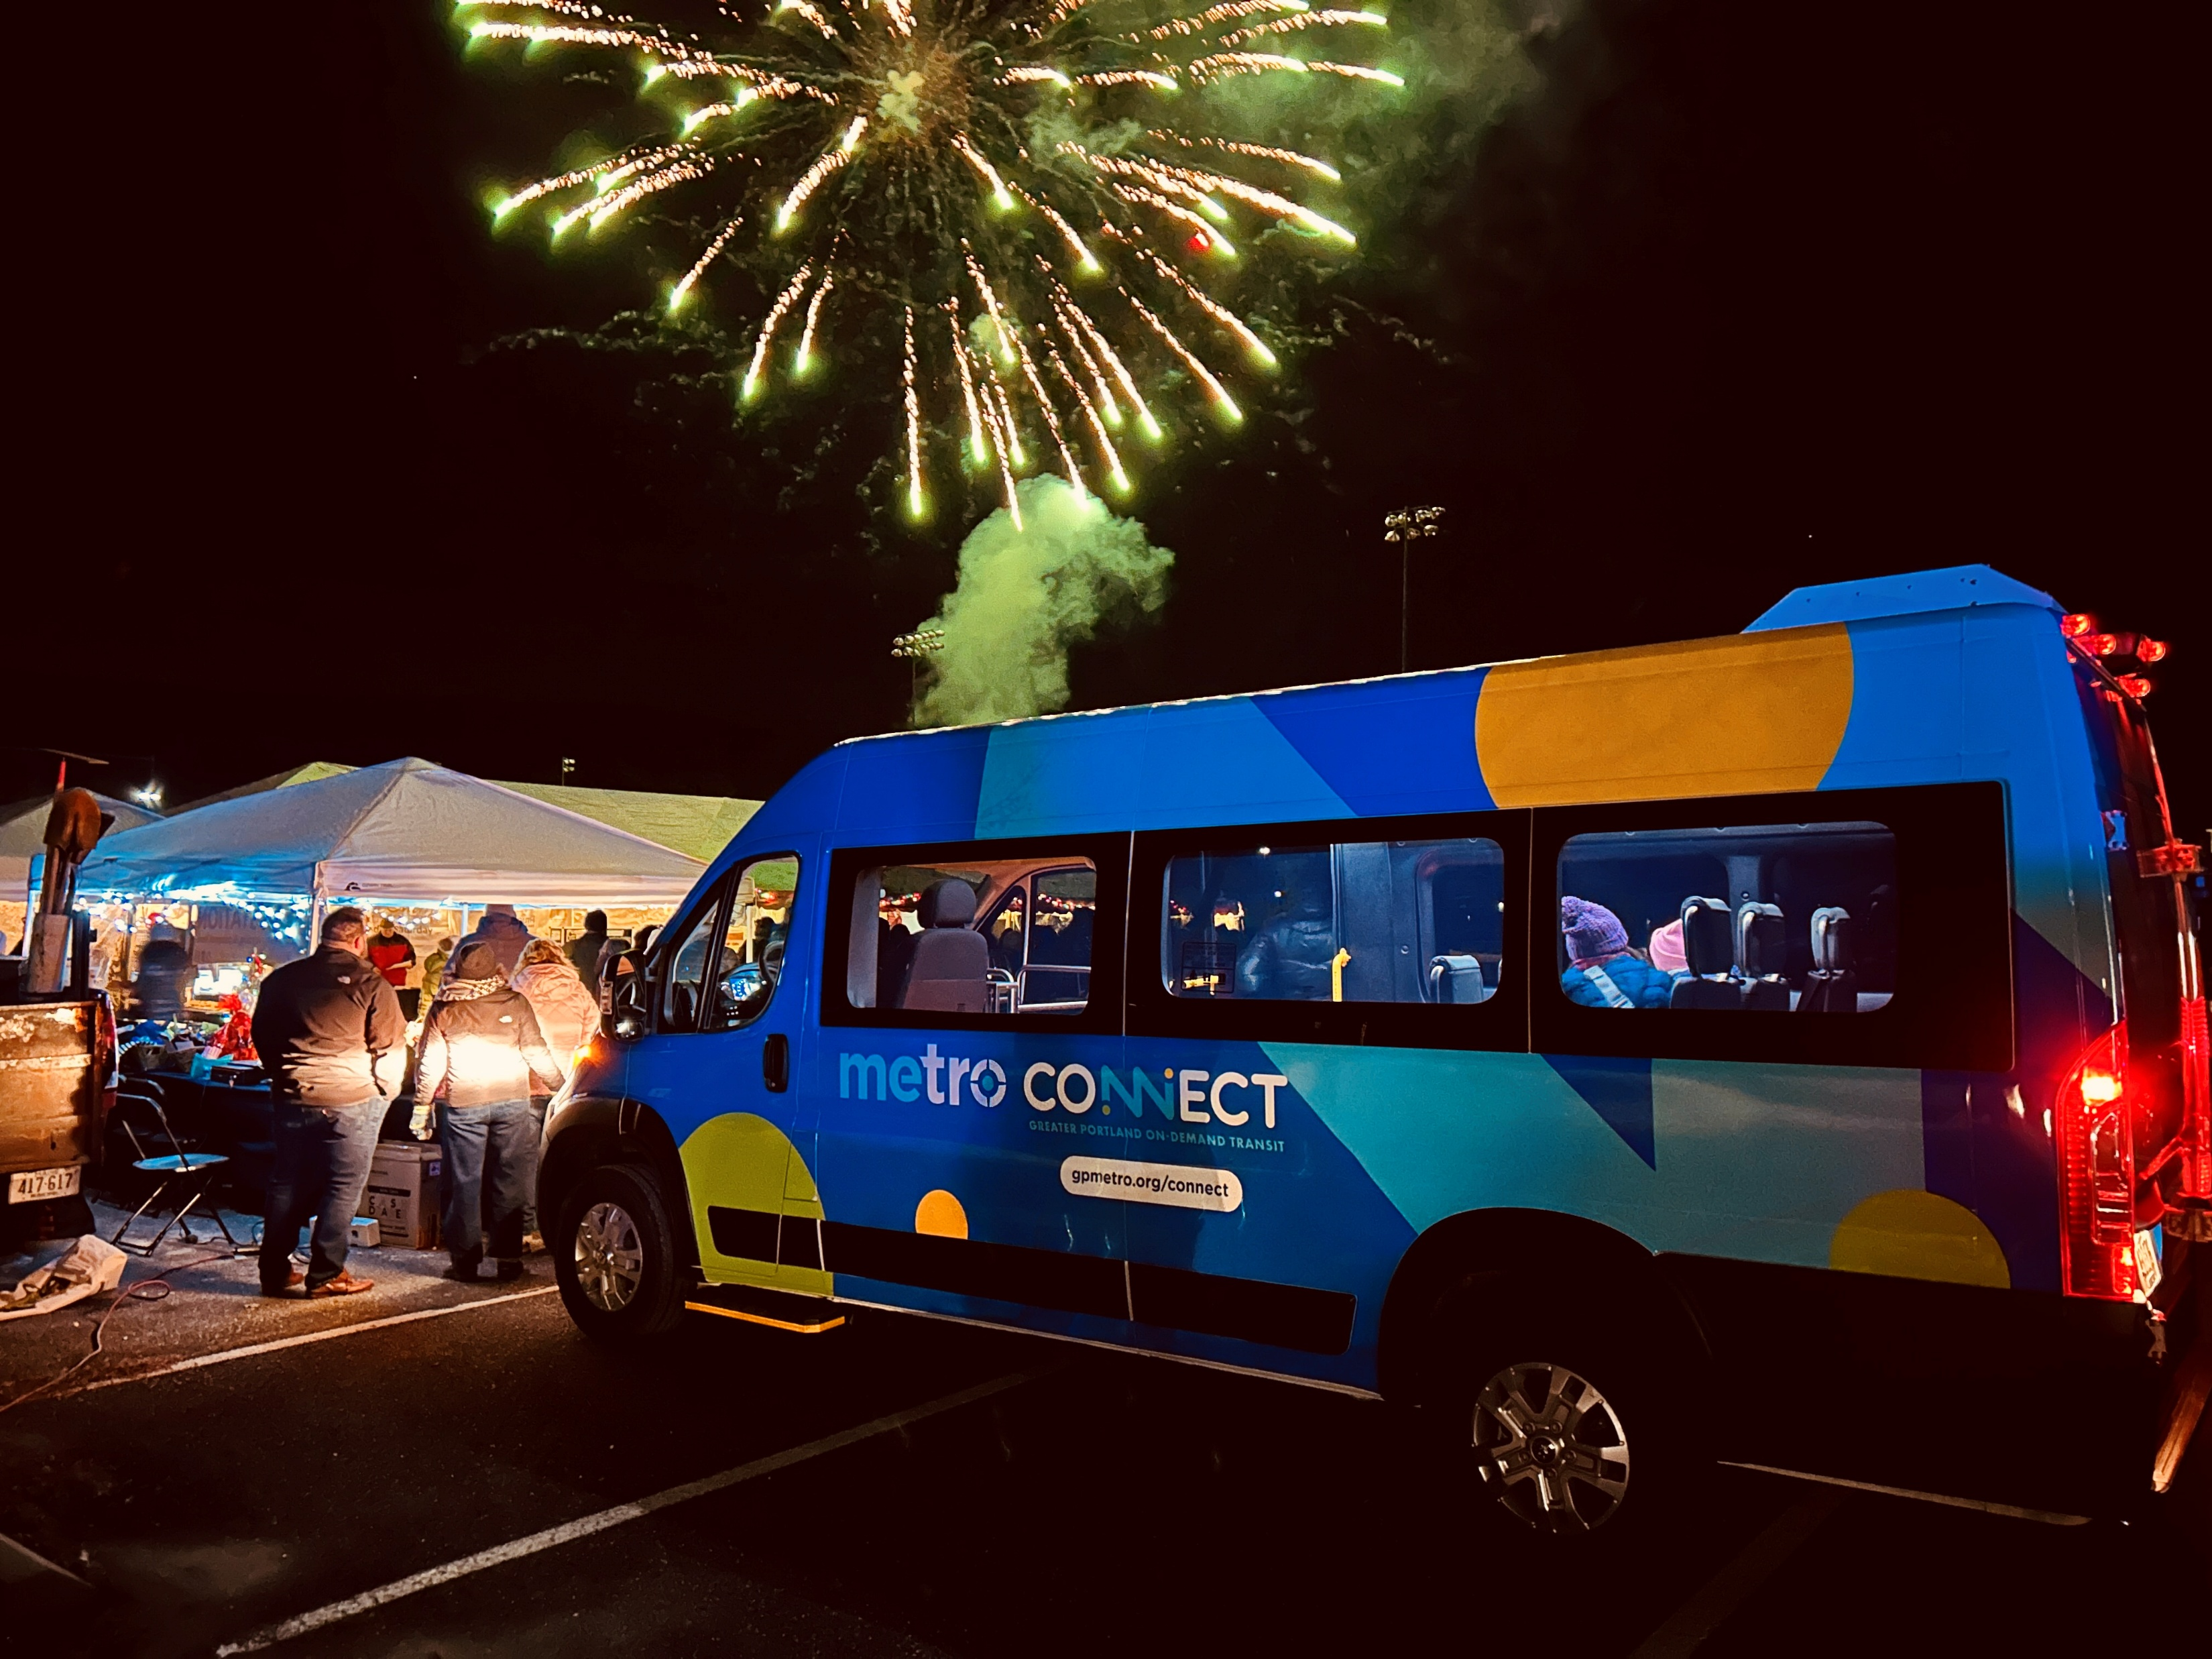
Questions and Discussion
Presented by:
Mike Tremblay
Director of Transit Development
Greater Portland Metro
September 4, 2025

