Slide 1
General Dynamics Bath Iron Works
Part of General Dynamics Marine Systems, Bath Iron Works is a full-service shipyard specializing in the design, building and support of complex surface combatants for the U.S. Navy. We’re Maine’s largest manufacturer with a 65-acre main shipyard in Bath that runs three shifts and additional office, warehouse and manufacturing locations for about 1600 employees primarily in the adjoining towns of West Bath and Brunswick.

Slide 2
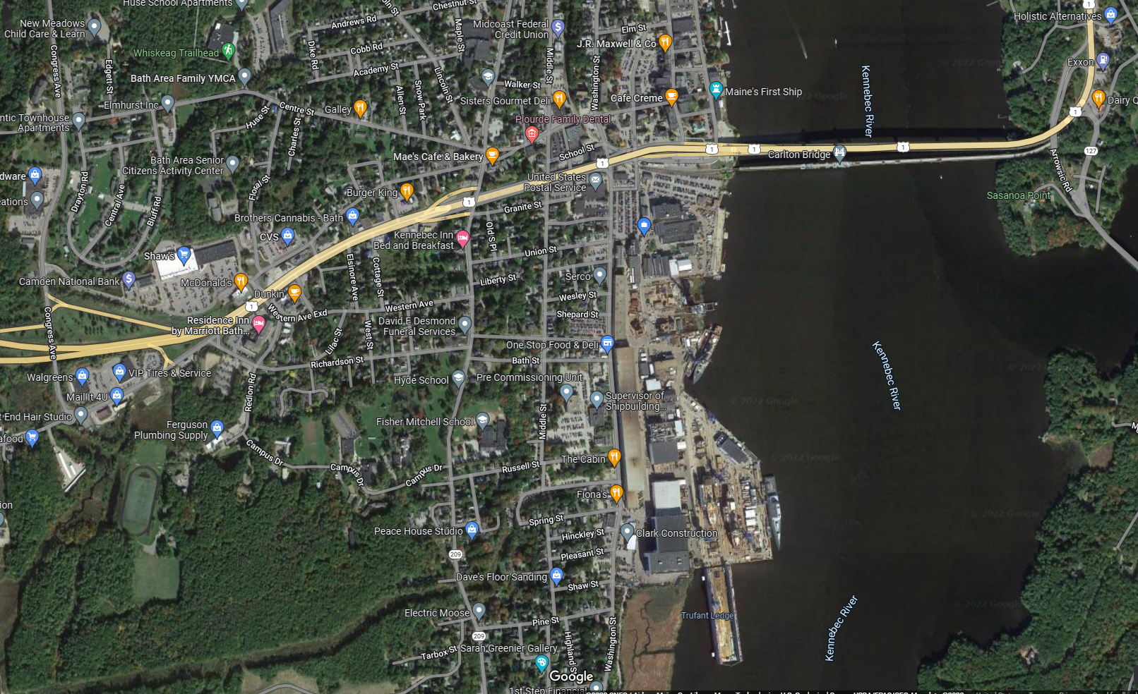
Main Shipyard in Bath

Slide 3
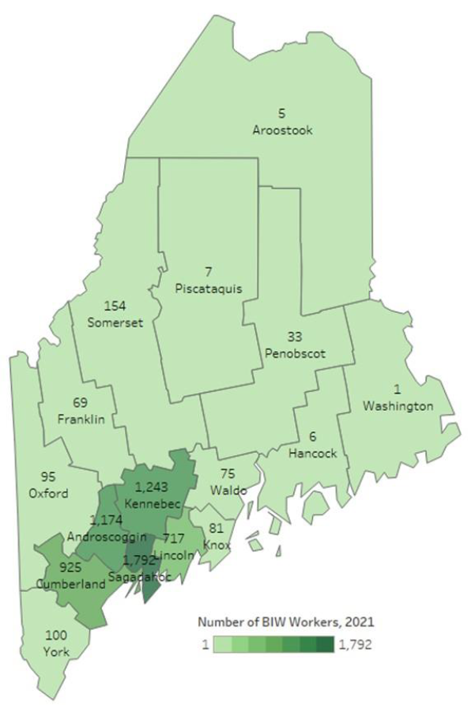
BIW’s Commuter and Parking Challenge
7,000 employees from all 16 counties in Maine on three shifts
Employee mix: about 4300 mechanics (no work computer access), 2700 office-based
Half of employees commute round-trip 70-plus miles per day
About 1800 parking spaces for 4000 people on first shift in the main yard

Slide 4
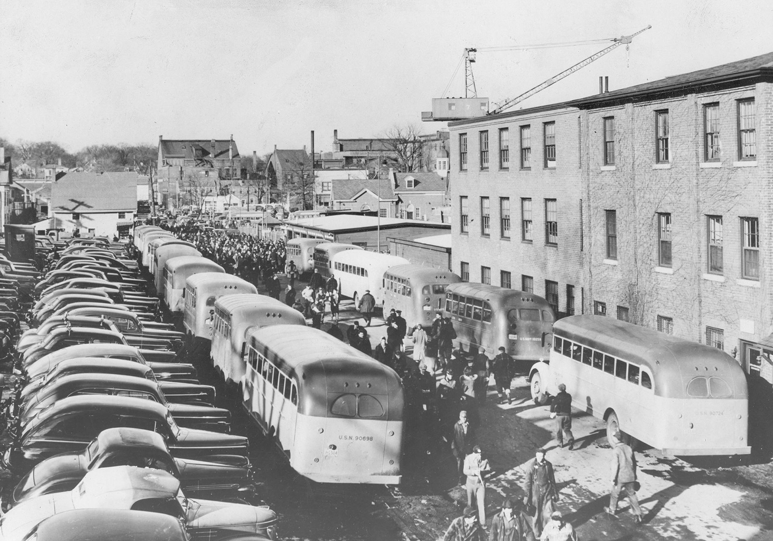
We have a long history of successfully using buses, carpools and vanpools going back to World War II.
Vans and carpools have preferred parking.
  Must meet minimum riders; van: minimum 7 people; car: minimum 3 people
Number of vanpools has declined in recent years.
Created a Parking and Transportation task force to address the Transportation Demand challenge

Slide 5
2022 Survey
Survey comments included the feeling that the current parking situation at BIW creates financial, emotional and time burdens on some employees.
Two thirds of respondents never use park and ride lots, and instead use BIW permitted lots, pay for private lot parking or use a BIW open lot.
More than half the respondents said they are interested in or willing to use park and ride, ridesharing, or regional busing options.

Slide 6
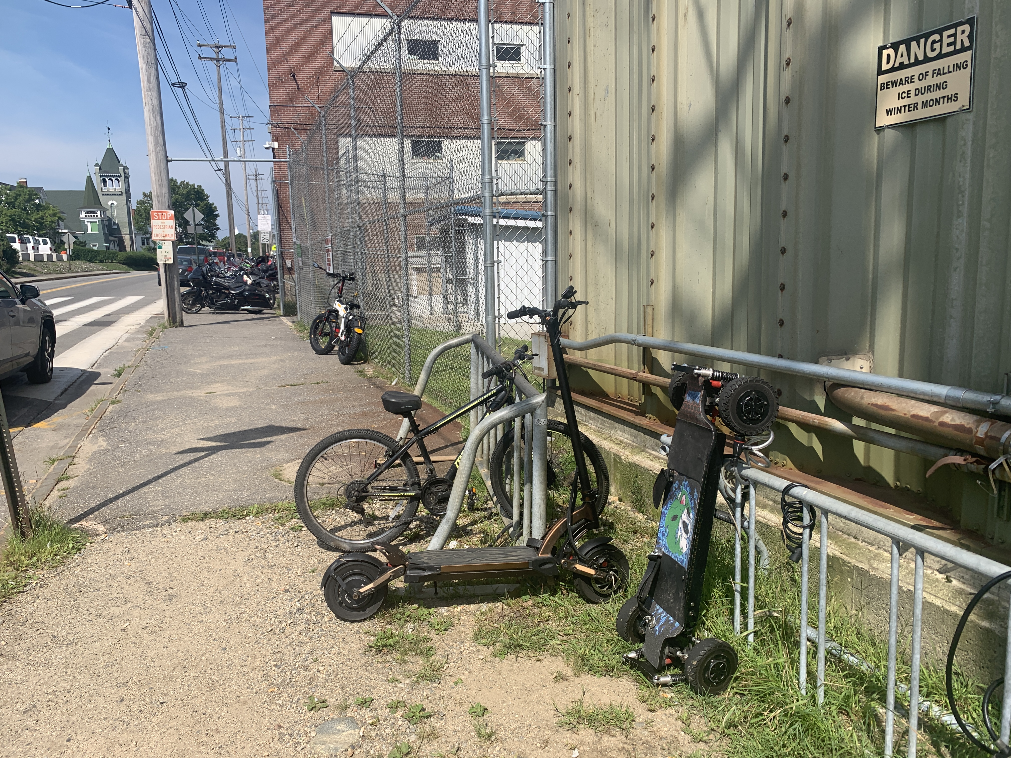
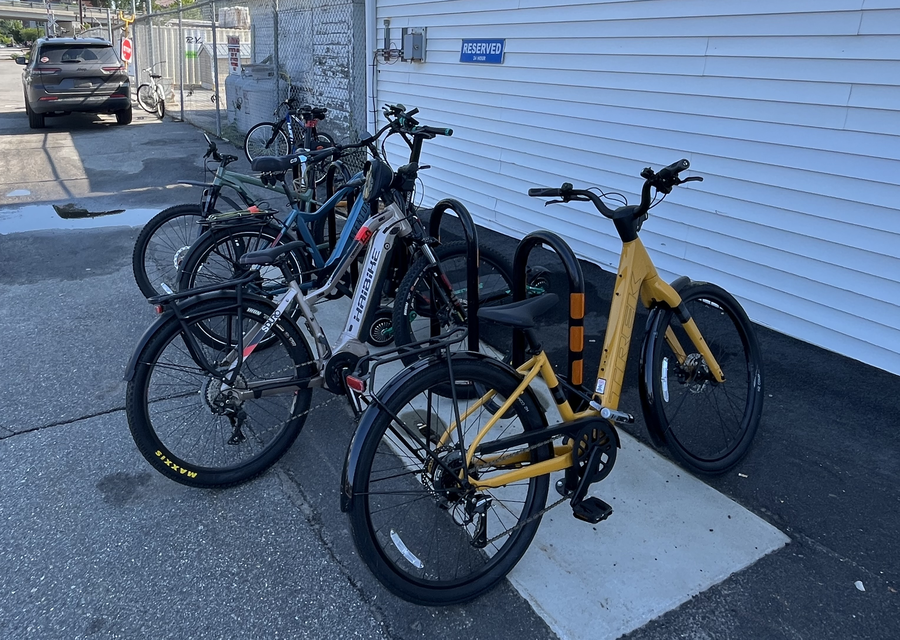
Task Force Follow Up
MaineDOT grant (2022–2026)
  Renewed and expanded partnership with GO MAINE
  Commuter Bus Pilots
  Improved bicycle storage (then and now)
  Shuttle/bus-stop shelters
  Improved park and rides (lighting, safety, incentives)
Washington Street Corridor Transportation and Parking Improvement Project (2024–2030)
  Garage
  Street redesign for pedestrian and bus safety
  Increased number of parking spaces will add dedicated carpool spaces

Slide 7
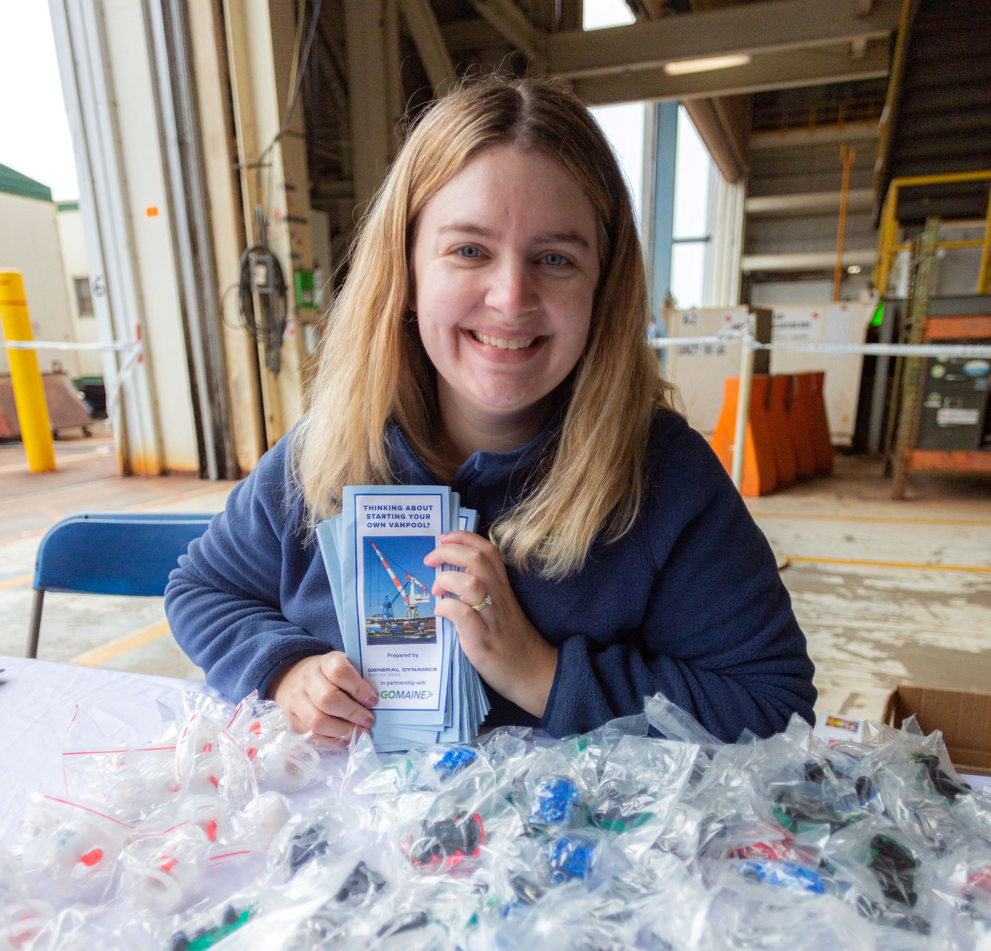
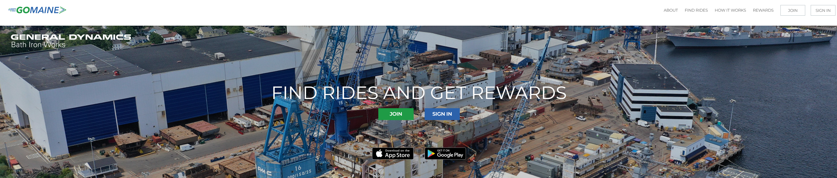
Partnership with GO MAINE
GO MAINE services meet several of BIW’s needs
  Has a free app to use to find rides
  No cost for employers to join or for employees to use
  Company-branded website links riders with fellow employees
  Matches/finds rides
  Rideshare can be ongoing or one-time
  Helps form car/vanpools and rideshares
  Provides emergency ride home coverage
  Rewards people for ridesharing and telecommuting

Slide 8
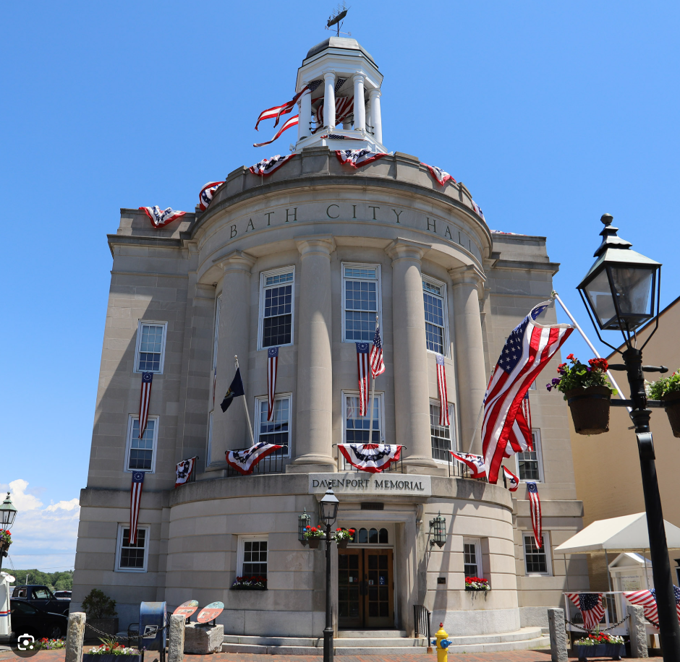
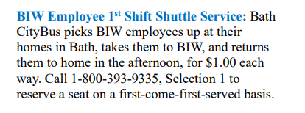
Bus Connections: Bath
City Bus for Bath Residents
  Operated by Western Maine Transportation Services (WMTS)
  $1 each way
  Currently full

Slide 9

Bus Connections: Lewiston
Lewiston Area BlueLine Express to BIW
  Launched 2023
  Operated by Western Maine Transportation Services (WMTS)
  Starts in Lewiston in morning and returns in afternoon
  Two seats are reserved for the public
  Can purchase tickets through Go Maine app, cash
  Pilot project

Slide 10
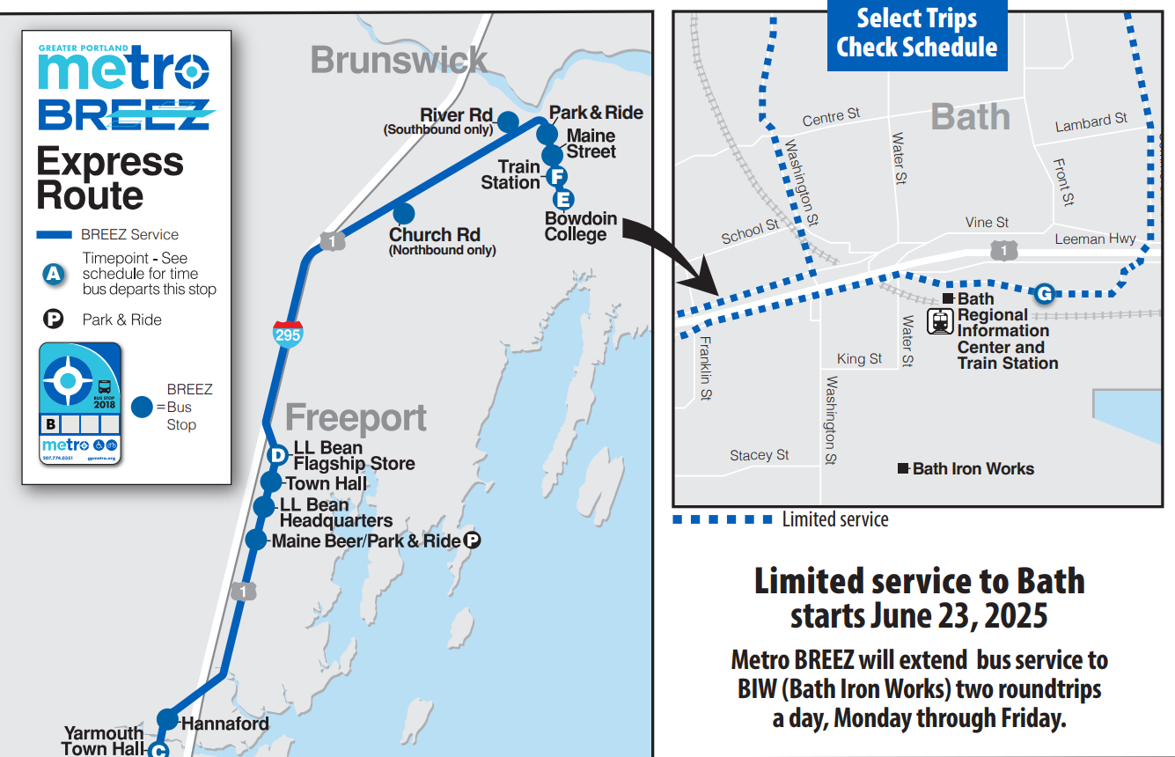
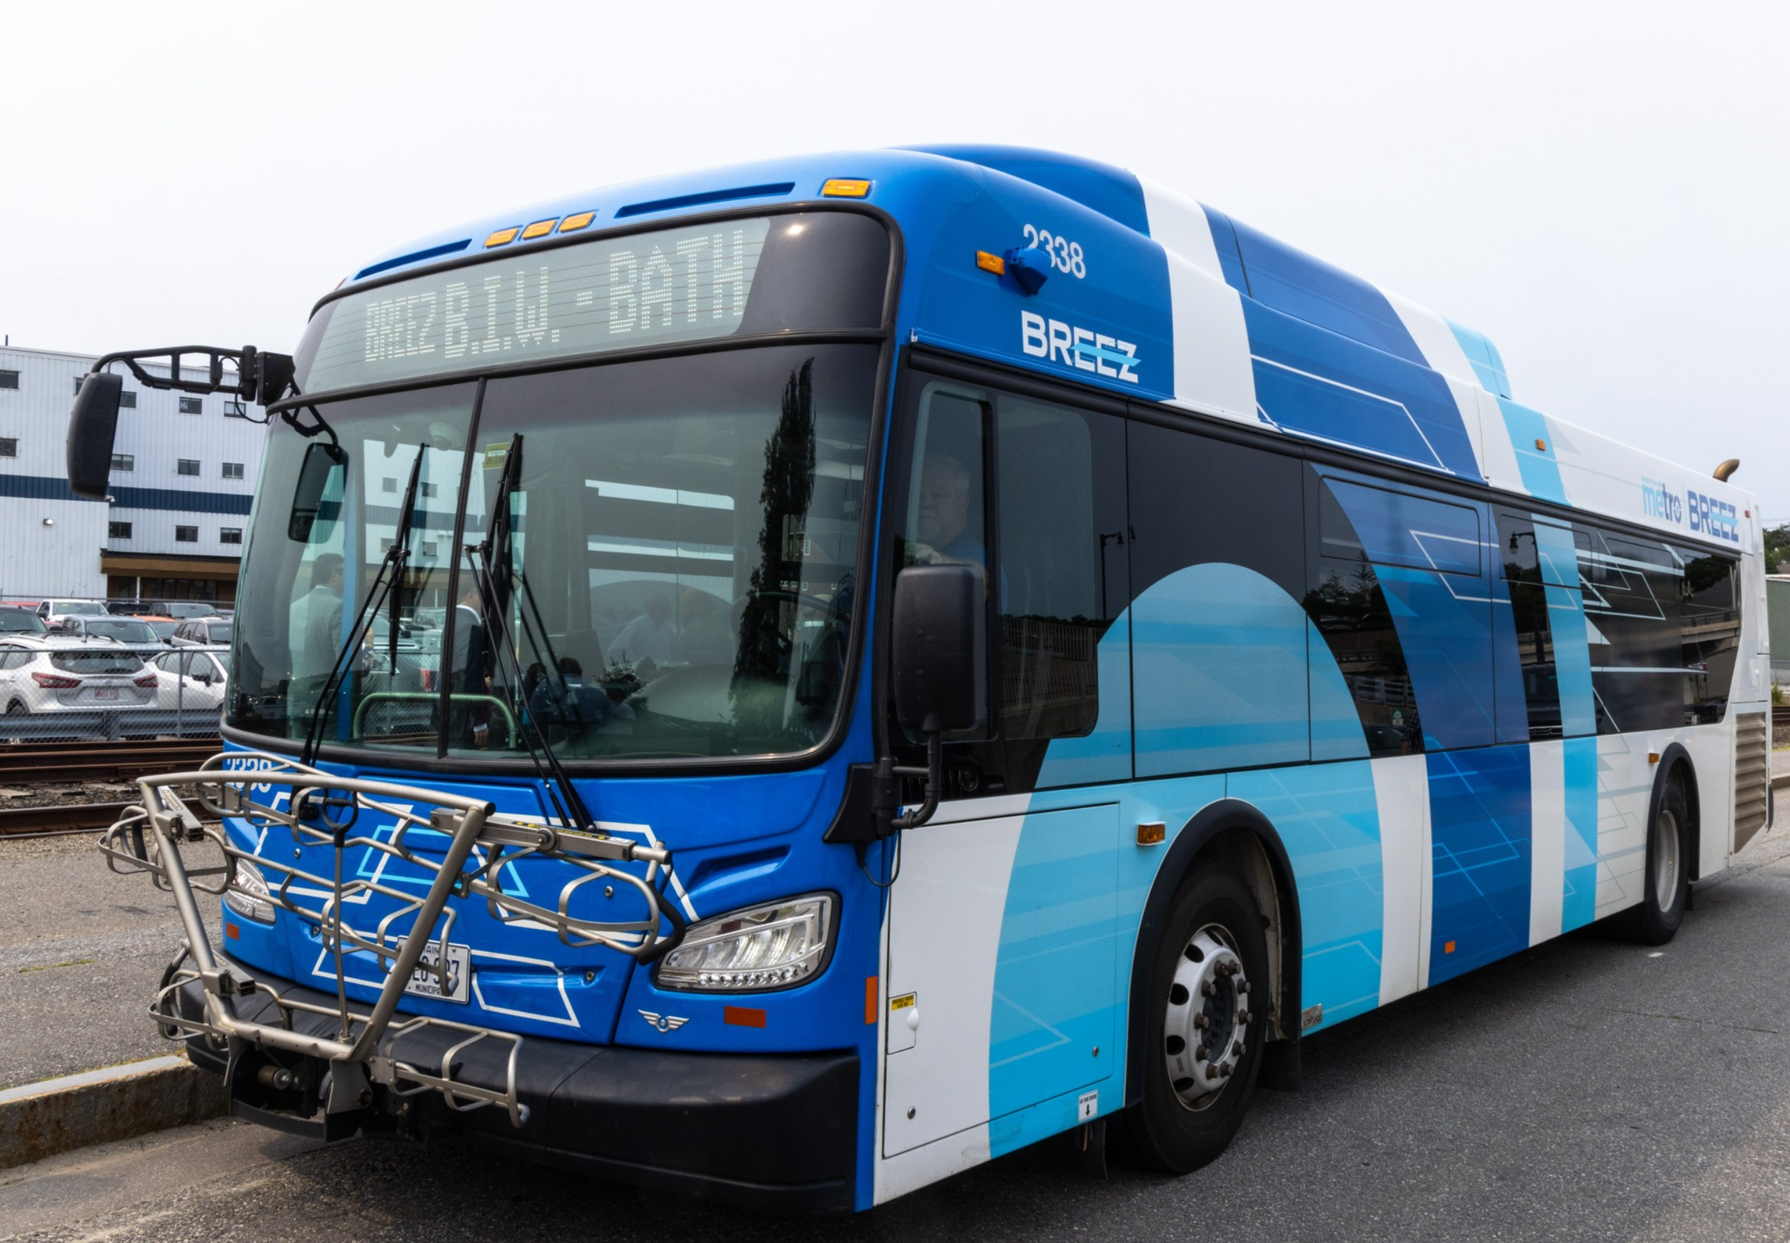
Bus Connections: Portland
Greater Portland Metro Service (BREEZ)
  Launched July 7, 2025 (soft launch June 23)
  Pilot project
First public transit connection for Bath to Portland area
  Connects Bath to Brunswick, Freeport, Yarmouth and Portland
  Allows connections to Amtrack and Portland Jetport
Public transportation, weekday service only
  Bus stop located at Bath Visitor’s Center adjacent to BIW
  Schedule aligns with BIW 1st Shift
    Arrives in Bath at 6:20 a.m.
    Leaves Bath at 3:40 p.m.

Slide 11
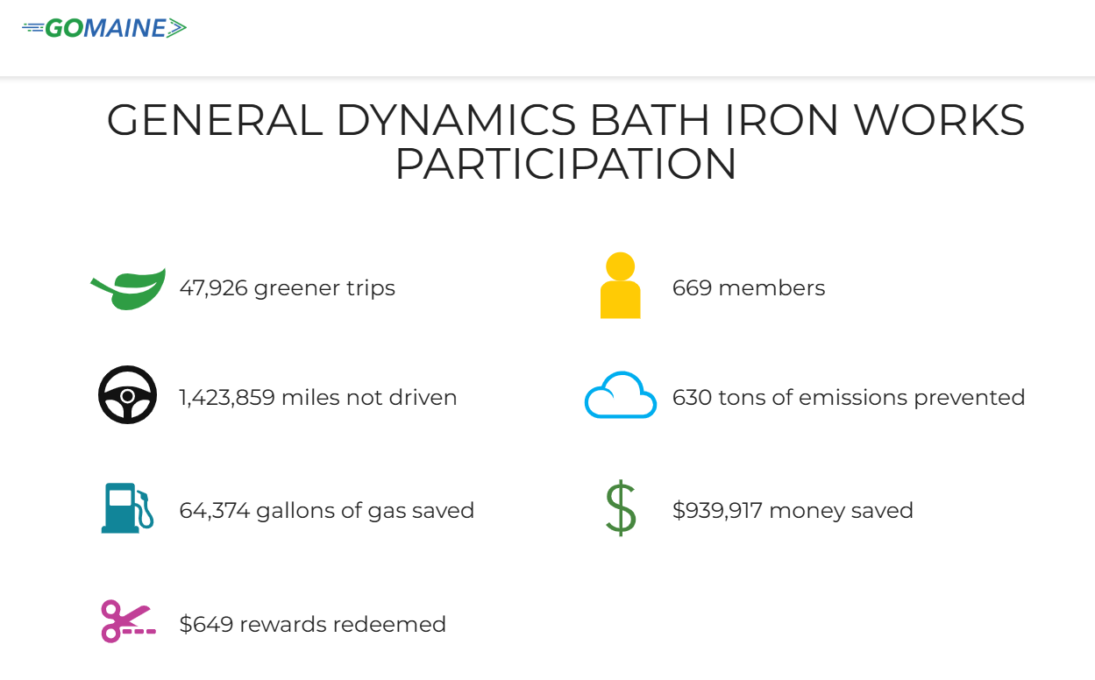
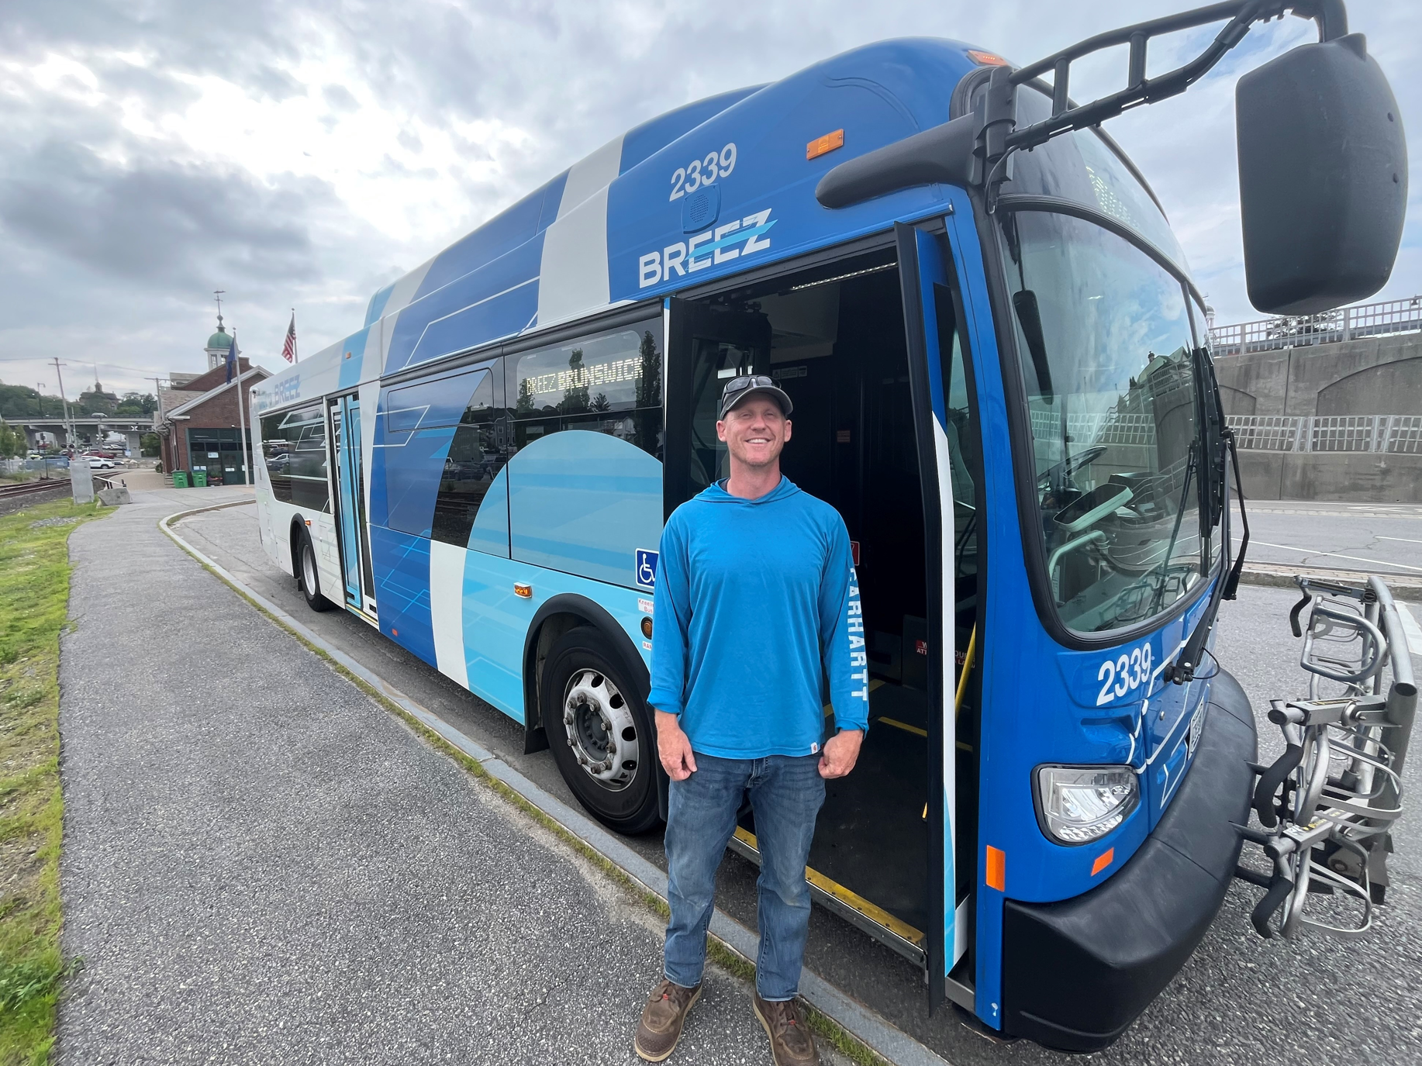
Transportation Success Story
State leader in encouraging green transportation alternatives
GO MAINE rideshare app partnership
  Won May 2025 GO MAINE Challenge for most green trips
45 Van pools and 135 carpools with incentivized parking
Commuter shuttle bus from Lewiston pilot since 2023
Metro BREEZ bus extension pilot launched July 2025
Upgraded bicycle racks in 2023
Allow work-from-home hybrid options and flex schedules for many office-based employees

