Slide 1

Federal Transit Administration
i
Tri-State Transit Conference 2025
Portland, ME

Slide 2
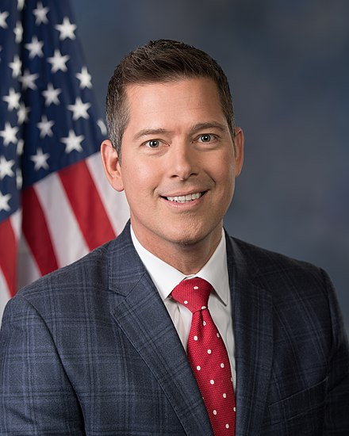
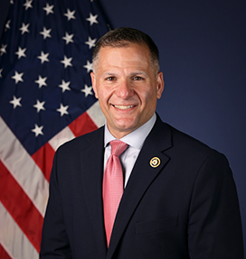
Leadership
Transportation Secretary Sean P. Duffy
FTA Administrator
Marc Molinaro

Slide 3


FTA’s Mission, Vision, and Values
Mission
Vision
Improve America’s Communities through Public Transportation
A Better Quality of Life for All Built on Public Transportation Excellence
Values
Service | Provide reliable, transparent, responsive, and anticipatory services to meet stakeholder needs.
Integrity | Commit to the highest professional and ethical standards.
Innovation | Foster new ideas, concepts, and solutions for improved outcomes.
Resiliency | Optimize decisions, resources, and systems to make long-term positive impacts on the environment, infrastructure, and safety.

Slide 4




FTA’s Operations
FTA operations and authority are defined by several elements:
FTA Mission, Vision, and Values
FTA Core Functions
FTA’s Lines of Business
Research
Financial Assistance
Technical Assistance
Oversight

Slide 5
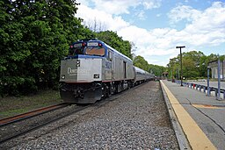
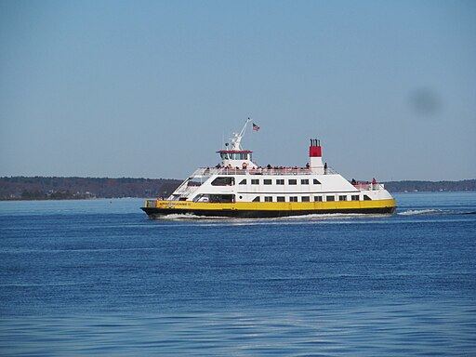
FTA provides $21 billion annually to support transit providers delivering 7 billion trips that connect transit riders to jobs, education, healthcare, and other activities.
FTA regulates the safety of
transit providers.

Slide 6
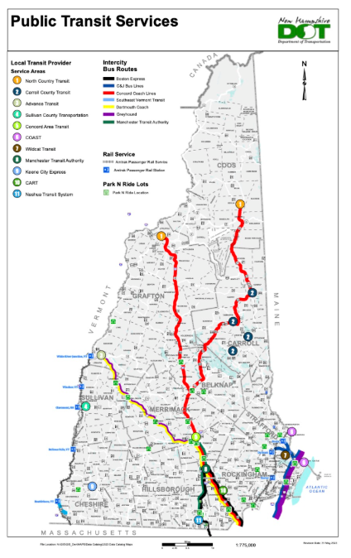
New Hampshire Recipients and Grants
Last year, FTA apportioned $24M to recipients in New Hampshire
As of this month, there are 5 FTA recipients in New Hampshire managing a portfolio of $127M in active FTA grants
Nearly 48% of these funds or, $61M have already been disbursed
(Source: FY2024 Full-Year Apportionment Tables, Regional Recipient Awards Dashboard, 2023 FTA National Transit Database (Sec. 5335) )

Slide 7
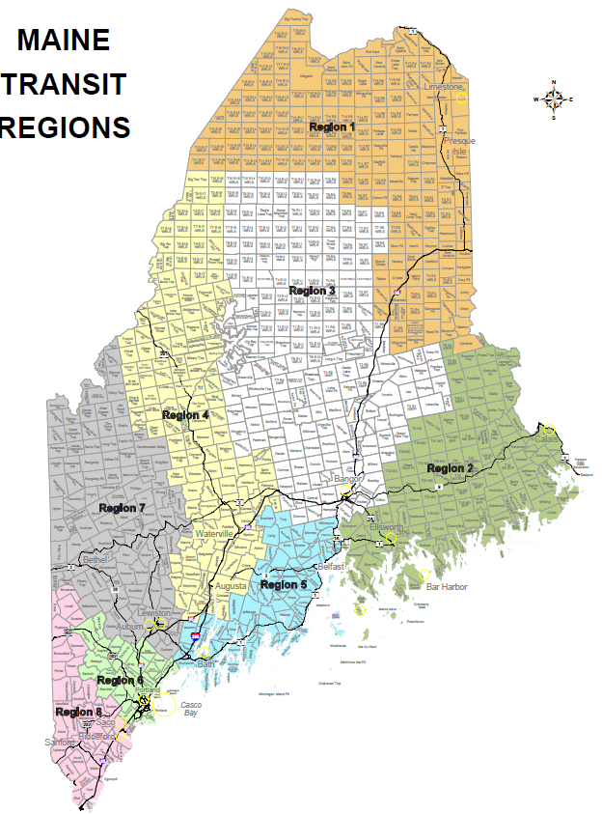
Maine Recipients and Grants
Last year, FTA apportioned $49M to recipients in Maine
As of this month, there are 10 FTA recipients in Maine managing a portfolio of $307M in active FTA grants
Nearly 65% of these funds or, $199M have already been disbursed
(Source: FY2024 Full-Year Apportionment Tables, Regional Recipient Awards Dashboard, 2023 FTA National Transit Database (Sec. 5335) )

Slide 8
Vermont Recipients and Grants
Last year, FTA apportioned near $15M to recipients in Vermont
As of this month, there are 2 FTA recipients in Vermont managing a portfolio of $181M in active FTA grants
Nearly 87% of these funds or, $157M have already been disbursed
(Source: FY2024 Full-Year Apportionment Tables, Regional Recipient Awards Dashboard, 2023 FTA National Transit Database (Sec. 5335) )

Slide 9
Upcoming Notice Of Funding Opportunities (NOFOs)

Slide 10
Upcoming NOFOs
NOFO | Operating Administration/Office
Ferry Programs: Electric or Low Emitting Ferry; Ferry Service for Rural Communities; Passenger Ferry Boat Program | Federal Transit Administration
Transit Oriented Development Planning | Federal Transit Administration
Strengthening Mobility & Revolutionizing Transportation (SMART) | Office of the Secretary
Notes:
Information regarding upcoming NOFOs can be found here: https://www.transportation.gov/infrastructure-investment-and-jobs-act/key-notices-funding-opportunity
https://www.transportation.gov/grants/dashboard

Slide 11
Recipient Tools Highlight

Slide 12
Recipient Toolkit and Circular Updates
Recipient toolkit includes:
Preliminary work for application development
Considerations for application planning
Key elements of an application
  information on developing the executive summary
  projects within the application
  budget descriptions
Navigate to transit.dot.gov: Funding > Grants > Applying > Existing Recipients > FTA Recipient Award Toolkit
New Circulars
FTA has updated its program guidance and award management requirements for several circulars
Updates and consolidation of circulars incorporate provisions from the Fixing America’s Surface (FAST) Act; the Infrastructure Investment and Jobs Act (IIJA) and the Uniform Administrative Requirements for Federal Awards
Navigate to transit.dot.gov: Funding > Regulations and Programs> FTA Circulars
And FTA 2024 Circular Update | FTA

Slide 13
Section 5307
Safety Requirement Highlight

Slide 14
Section 5307 Safety Requirement
As part of 49 U.S.C. 5329(d)(4)(B) via Bipartisan Infrastructure Law at a minimum 0.75% of a transit agencies Section 5307 funding must be allocated to safety-related projects.
Beginning on October 1, 2021, all Section 5307 recipients in large UZAs (equal to or greater than 200 in population) must comply with the requirement.
Unlike the 1% security requirement, no exemptions via certification.

Slide 15
Safety Requirement - How to Operationalize
Safety is a goal and not a specific type of expense
  Wide variety of expenses could be identified as safety-related
  Could be integral to activities already otherwise proposed by recipients
APPLIES TO: All grants involving Section 5307 funds obligated on or after October 1, 2021
  BIL funds (FFY 2022 and beyond)
  Unobligated prior-year 5307 funds (pre-FFY 2022)
  Unobligated CARES, CRRSAA, and ARP funds (includes ARP additional assistance funding)
APPLIED AT: The individual recipient and grant levels
  0.75% of budget for each grant for each recipient
  Safety as a goal → No separate/distinct ALIs for safety-related projects
  Can be part of ALIs or scopes for projects recipient considers safety-related
  Short narrative noting how requirement is satisfied

Slide 16
Safety Requirement - Other Important Notes
Should not merely be satisfied as total expenditure for UZA as a whole, unlike 1% security requirement → All recipients participate in safety expenditure
Recipients serving more than one large UZA encouraged to spend minimum 0.75% in each, but not required
Can be satisfied as a capital or planning activity or through operating assistance (if recipient is otherwise eligible)
Can be overlap in satisfying minimum expenditure requirements for both safety and security

Slide 17
Period of Performance
Tips and Tricks

Slide 18

Period of Performance – Background
All FTA Awards must include a period of performance (POP).
Circular 5010.1F defines the period of performance as the time during which the recipient or subrecipient may incur obligations to carry out the scope of work authorized under the award.
The period of performance begins on the Start Date and concludes on the End Date.
FTA defines the Start Date as the Federal Award Date (or obligation date) of an award, and this is prepopulated in TrAMS.
No costs may be incurred after the period of performance end date.

Slide 19
Period of Performance - TrAMS Enhancements
FTA recipients must expend awards timely and close out projects and awards at the end of the period of performance or when award’s scope of work is completed.
The period of performance may only be changed in TrAMS via an amendment or budget revision.
FTA introduced a series of POP monitoring enhancements including validations, warning banners and alerts in its Transit Award Management System (TrAMS) that helps ensure recipients are (1) inputting valid POP end dates and (2) notifying recipients if a POP end date is within 30 days of expiring or has expired.
It is the recipient’s responsibility to contact FTA regional office staff to coordinate a new end date. The Regional Office will assist with determining the best path forward with updating the POP end date.

Slide 20
FTA’s Region 1 Contacts
Region 1 email address | ftaregion1@dot.gov
Peter Butler, Regional Administrator | peter.butler@dot.gov
Michelle Muhlanger, Deputy Regional Administrator | michelle.muhlanger@dot.gov
Brandon Burns, Massachusetts Pre Award Manager | michael.burns1@dot.gov
Jon Schmidt, Massachusetts NEPA & Planning | jonathan.schmidt@dot.gov
Sean McGrath, Massachusetts Post Award Manager, Capital Projects | sean.mcgrath@dot.gov

