Slide 1
GPMetro’s Strategic Investment in Technology
Chad Heid, CTO GPMetro cheid@gpmetro.org

Slide 2
Technology as a Strategic Enabler
Transit agencies are under-resourced with many demands.
Software-as-a-Service (SaaS) as a method to bridge the gap.
These tools benefit:
  Customers: with real-time information and flexible services.
  Employees: by streamlining tasks and improving the work environment.
  The Agency: by maximizing service and optimizing resource allocation.
Staffing & Skills Gaps: Saas can reduce administrative overhead and provide a platform for continuous learning, helping our workforce adapt to new technologies.

Slide 3
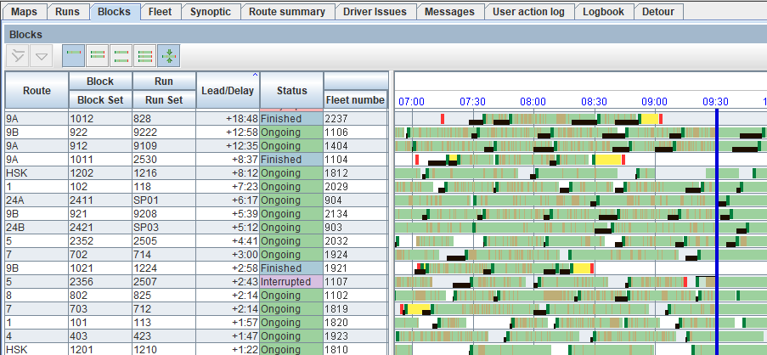

Equans Navineo: The Brain of Operations
Feature: CAD/AVL system provides real-time data, on-time performance data, playback, and more.
Benefit: Enables dispatchers to manage service, respond to delays, communicate with customers and operators.
Manager Use: Reporting and analytics to improve operator performance, schedule adherence, and fleet reliability.

Slide 4
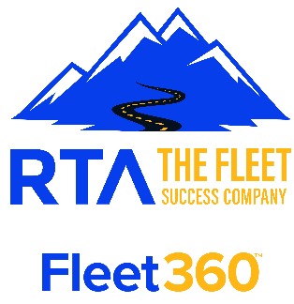
Ron Turley Associates (RTA): Optimizing the Fleet
Feature: The Fleet Maintenance Information System (FMIS) manages maintenance schedules, work orders, and (eventually)parts inventory.
Benefit: Ensures a well-maintained fleet, reducing costly breakdowns and extending vehicle lifespan.
Manager Use: Analyze fleet trends, implement campaign work, and evaluate parts usage to forecast inventory needs.

Slide 5
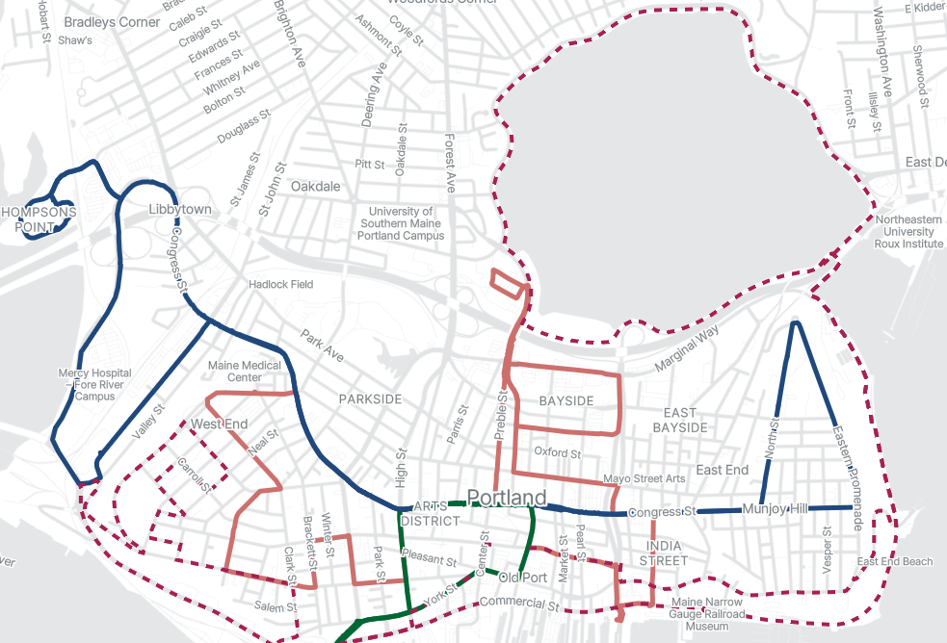
Optibus: Planning & Scheduling
Optibus – PSR: Service planning, scheduling, and run-cutting.
Remix: Platform that visualizes transit data
and demographics, aiding in Title VI analysis,
and produces public facing maps.
Benefit: Aligns service with ridership demand, reducing costs and maximizing service hours.
Manager Use: Planners use ridership data to create efficient schedules and optimize driver assignments, making a small team far more productive.

Slide 6
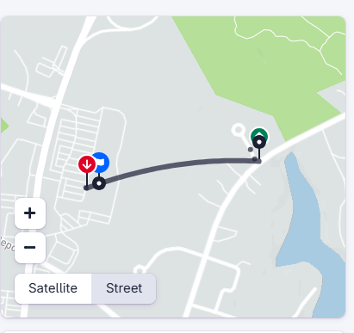
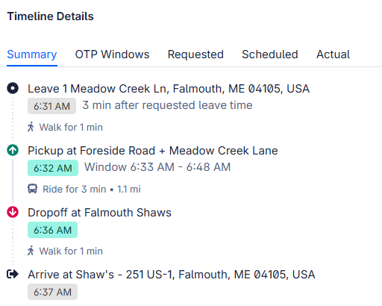
Spare: The Microtransit Solution
Feature: Our on-demand platform for microtransit service.
Benefit: Provides first/last-mile solutions and expands service to lower-density areas without the cost of a fixed route.
Manager Use: Monitor wait times to adjust vehicle allocation in real-time. The system automates booking and dispatch, reducing the need for administrative staff.

Slide 7
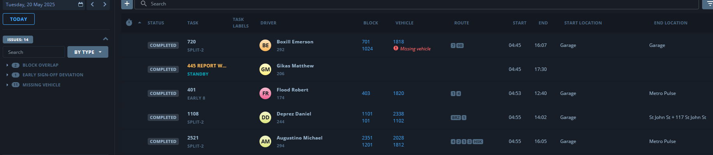
Optibus Operations
Feature: Centralize payroll and operator bidding, along with providing real time communications between staff.
Benefit: Reduce payroll processing time and automate job assignment reporting. Improve data accuracy and transparency.
Manager Use: Tracking payroll hours, attendance deviations, pay to platform time, and improving resource utilization.

Slide 8
Internal Efficiency: Zendesk & Tyler Technologies Munis
Zendesk: IT helpdesk tool streamlines IT support and ticketing.
Benefit: Ensures employees can get back to their work quickly, reducing administrative overhead for a small IT team.
Tyler Technologies - Munis: Financial and HR solution centralizes administrative functions.
Benefit: Frees up staff to focus on transit operations by partially automating payroll, financial reporting, and other HR processes

Slide 9
Cubic/Umo: Critical Fare Collection & Customer Experience
Feature: A mission-critical fare collection system that tracks ridership and revenue with seamless mobile and smart card ticketing.
Benefit: Provides a clear, automated source of revenue data and eliminates the need for manual fare counting.
Manager Use: Planning and Operations uses ridership data to justify service frequency adjustments on high-demand routes and potential service cuts on under-performing routes.

Slide 10
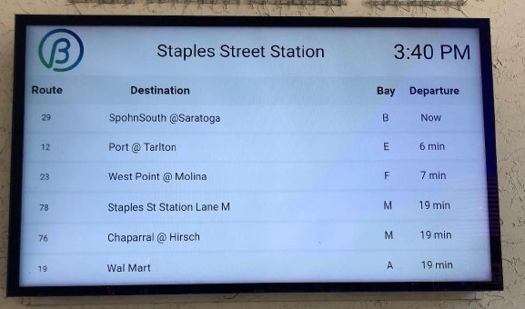
Real Time Sign and Content Management
Customer Advancement: Targeted for 2026, we will deploy real-time displays at high ridership stops, providing live bus location and arrival times to enhance the customer experience.

Slide 11
Inherited Systems from South Portland Bus Service
The consolidation brought a new data ecosystem with Swiftly, Samsara, and Trillium.
Swiftly: Provides insights into historical on-time performance and service reliability, along with providing playback for investigations.
Samsara: Monitors vehicle health and driver behavior to improve safety and maintenance, helping to upskill the workforce. Especially useful on non-revenue fleets.
Trillium: GTFS data management service that ensures transit data is accurate and accessible as a multi-route map.

Slide 12
Conclusion & The Future
Strategic investment in SaaS solutions is non-negotiable for modern transit agencies.
Despite being under-resourced, GP Metro is using technology to innovate and deliver a superior experience.
As technologies are deployed, it is critical to consider the timeline for training, testing, and validation.

